Slide 1
Kubernetes
Kubernetes Up & Running
Part II
2026.08.25

Slide 2
Common Kubectl Command

Slide 3
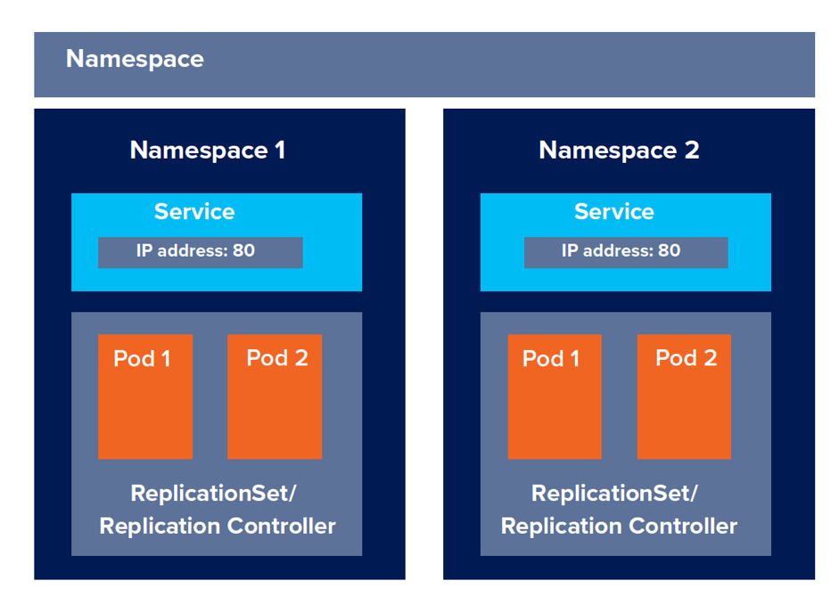
Namespaces
Organizing Objects :
  Kubernetes uses namespaces to organize objects in the cluster. You can think of each namespace as a folder that holds a set of objects. By default, the “kubectl command-line tool” interacts with the default namespace. If you want to use a different namespace, you can pass kubectl the “--namespace” flag.
  For example, “kubectl --namespace=mystuff” references objects in the “mystuff” namespace. If you want to interact with all namespaces—for example, to list all Pods in your cluster—you can pass the “--all-namespaces” flag.

Slide 4
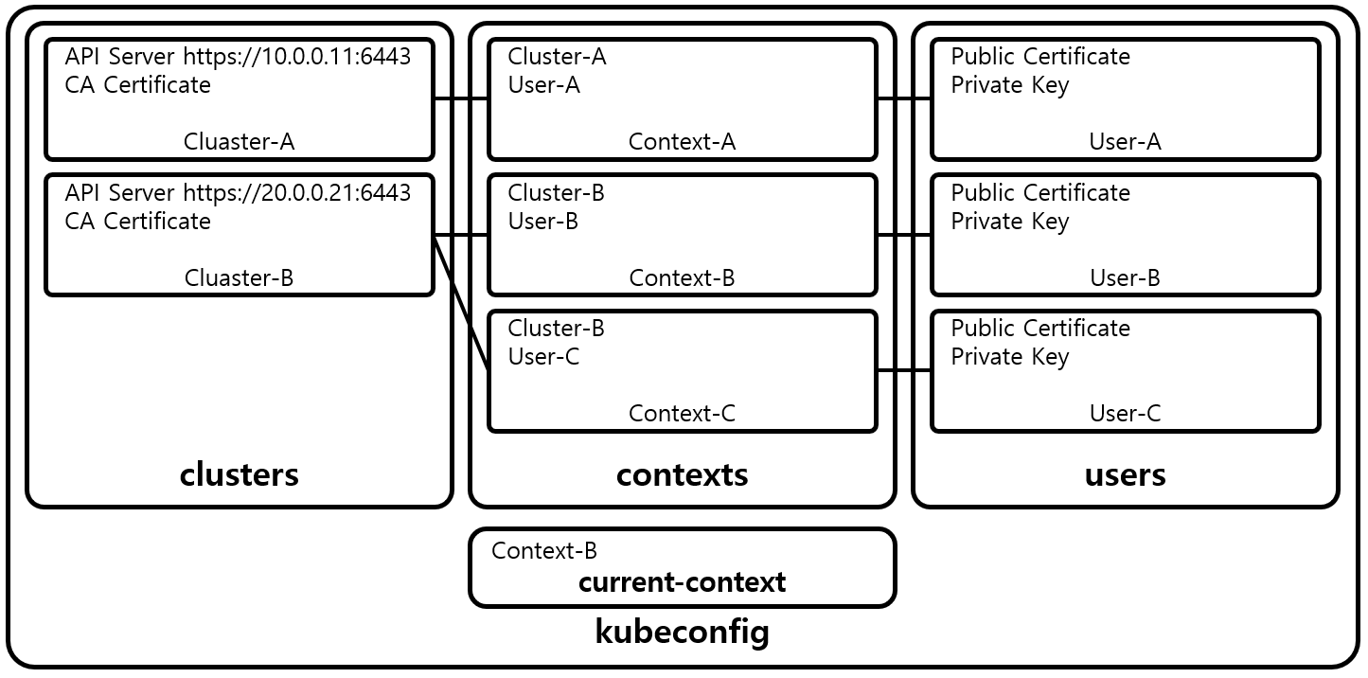
Contexts
Changing the Default Namespace :
  If you want to change the default namespace more permanently, you can use a context. This gets recorded in a “kubectl configuration file”, usually located at “$HOME/.kube/config”. This configuration file also stores how to both find and authenticate to your cluster. For example, you can create a context with a different default namespace for your kubectl commands using :
  This creates a new context, but it doesn’t actually start using it yet. To use this newly created context, you can run :
  Contexts can also be used to manage different clusters or different users for authenticating to those clusters using the “--users” or “--clusters” flags with the “set-context” command.
$ kubectl config set-context my-context --namespace=mystuff
$ kubectl config use-context my-context

Slide 5
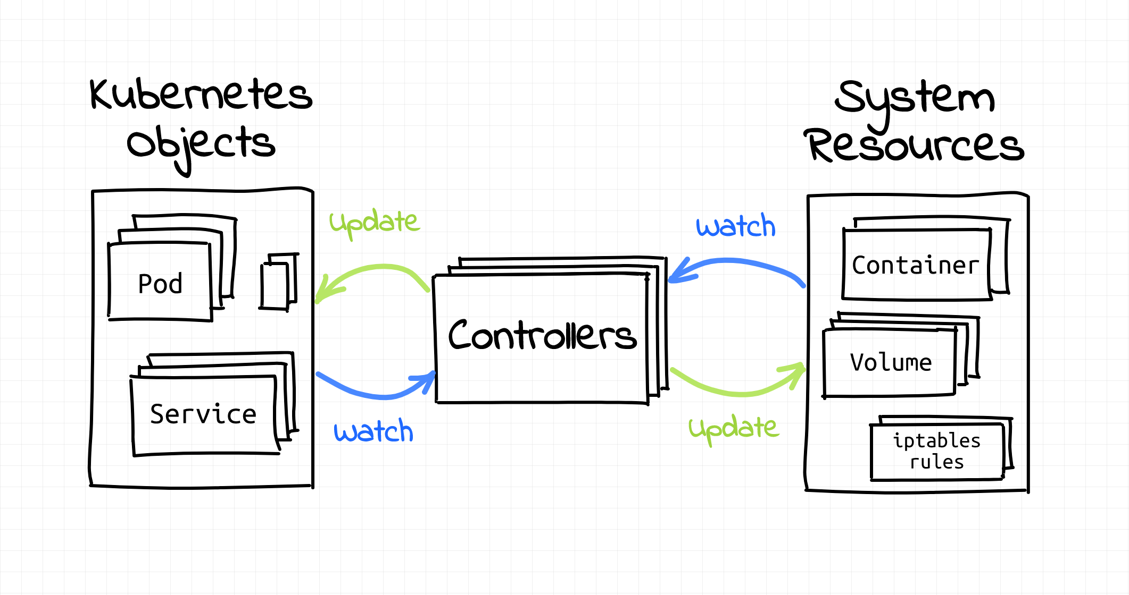
Viewing Kubernetes API Objects(1/2)
Reading Kubernetes Objects :
  Everything contained in Kubernetes is represented by a RESTful resource. We refer to these resources as Kubernetes objects. Each Kubernetes object exists at a unique HTTP path; for example, “https://your-k8s.com/api/v1/namespaces/default/pods/my-pod” leads to the representation of a Pod in the default namespace named “my-pod”. The kubectl command makes HTTP requests to these URLs to access the Kubernetes objects that reside at these paths.
  The most basic command for viewing Kubernetes objects via kubectl is get. If you run “kubectl get <resource-name>” you will get a listing of all resources in the current namespace. If you want to get a specific resource, you can use “kubectl get <resource-name> <obj-name>”.
  By default, kubectl uses a human-readable printer for viewing the responses from the API server, but this human-readable printer removes many of the details of the objects to fit each object on one terminal line. One way to get slightly more information is to add the “-o wide” flag, which gives more details, on a longer line. If you want to view the complete object, you can also view the objects as raw JSON or YAML using the “-o json” or “-o yaml” flags, respectively.
  A common option for manipulating the output of kubectl is to remove the headers, which is often useful when combining kubectl with Unix pipes (e.g., “kubectl ... | awk ...”). If you specify the “--no-headers” flag, kubectl will skip the headers at the top of the human-readable table.

Slide 6
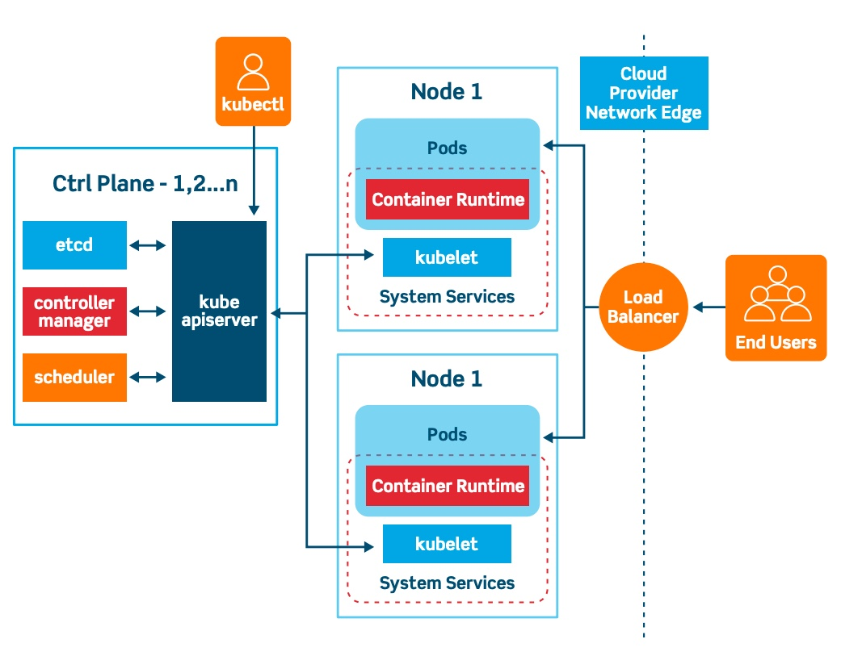
Viewing Kubernetes API Objects(2/2)
Reading Kubernetes Objects :
  Another common task is extracting specific fields from the object. kubectl uses the “JSONPath” query language to select fields in the returned object. For example, the following command will extract and print the IP address of the specified Pod :
  If you are interested in more detailed information about a particular object, use the describe command :
  This will provide a rich multiline human-readable description of the object as well as any other relevant, related objects and events in the Kubernetes cluster.
$ kubectl get pods my-pod -o jsonpath --template={.status.podIP}
$ kubectl describe <resource-name> <obj-name>

Slide 7
Creating, Updating, and Destroying Kubernetes Objects(1/2)
Object Creation and Updating :
  Objects in the Kubernetes API are represented as JSON or YAML files. These files are either returned by the server in response to a query or posted to the server as part of an API request. You can use these YAML or JSON files to create, update, or delete objects on the Kubernetes server.
  Let’s assume that you have a simple object stored in “obj.yaml”. You can use kubectl to create the object in Kubernetes by running :
  Notice that you don’t need to specify the resource type of the object; it’s obtained from the object file itself.
  Similarly, after you make changes to the object, you can use the apply command again to update the object :
  The apply tool will only modify objects that are different from the current objects in the cluster. If the objects you are creating already exist in the cluster, it will simply exit successfully without making any changes. This makes it useful for loops where you want to ensure the state of the cluster matches the state of the filesystem.
$ kubectl apply -f obj.yaml
$ kubectl apply -f obj.yaml

Slide 8
Creating, Updating, and Destroying Kubernetes Objects(2/2)
Object Creation and Updating :
  If you want to see what the apply command will do without actually making the changes, you can use the “--dry-run” flag to print the objects to the terminal without actually sending them to the server.
  NOTE : If you feel like making interactive edits instead of editing a local file, you can instead use the “edit“ command, which will download the latest object state and then launch an editor that contains the definition. After you save the file, it will be automatically uploaded back to the Kubernetes cluster.
  The “apply” command also records the history of previous configurations in an annotation within the object. You can manipulate these records with the “edit-last-applied”, “set-last-applied”, and “view-last-applied” commands. For example :
  When you want to delete an object, you can simply run :
  It is important to note that kubectl will not prompt you to confirm the deletion. Once you issue the command, the object will be deleted. Likewise, you also can delete an object using the resource type and name :
$ kubectl edit <resource-name> <obj-name>
$ kubectl apply -f myobj.yaml view-last-applied
$ kubectl delete -f obj.yaml
$ kubectl delete <resource-name> <obj-name>

Slide 9
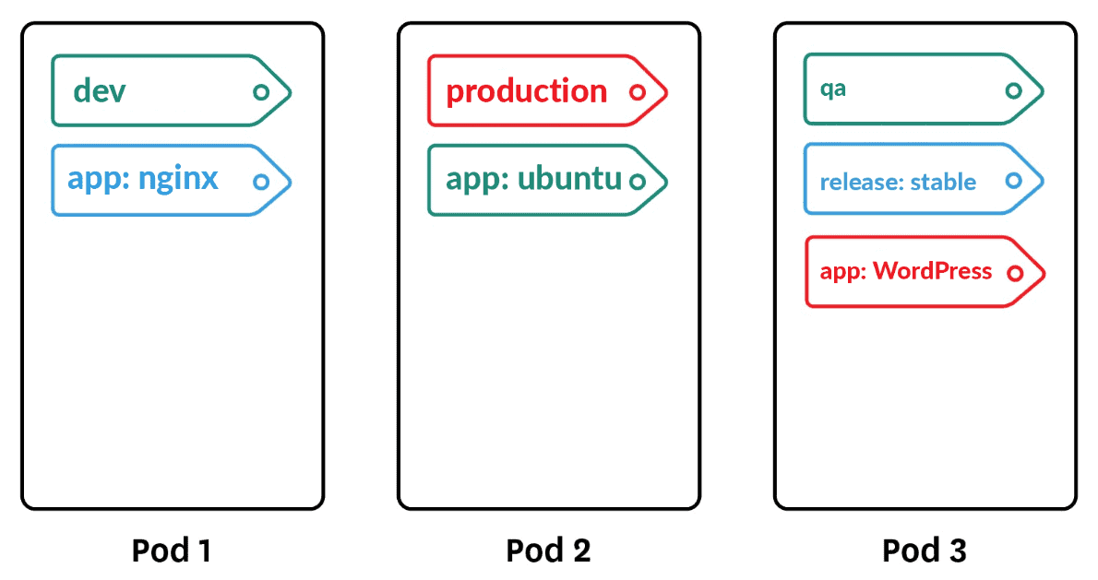
Labeling and Annotating Objects
Annotation and Label :
  Labels and annotations are tags for your objects. You can update the labels and annotations on any Kubernetes object using the “annotate” and “label” commands. For example, to add the “color=red” label to a Pod named “bar”, you can run :
  The syntax for annotations is identical.
  By default, label and annotate will not let you overwrite an existing label. To do this, you need to add the “--overwrite” flag.
  If you want to remove a label, you can use the “<label-name>-” syntax :
  This will remove the color label from the Pod named bar.
$ kubectl label pods bar color=red
$ kubectl label pods bar color-

Slide 10
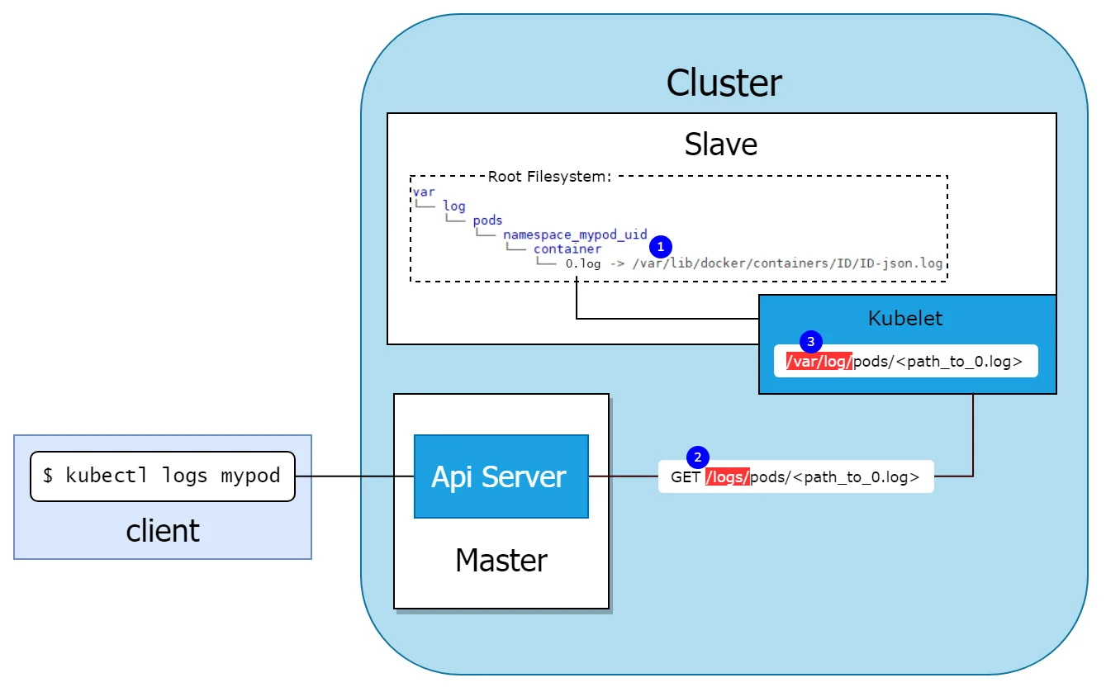
Debugging Commands(1/3)
Logging :
  kubectl also makes a number of commands available for debugging your containers. You can use the following to see the logs for a running container:
  If you have multiple containers in your Pod, you can choose the container to view using the “-c” flag.
  By default, kubectl logs lists the current logs and exits. If you instead want to continuously stream the logs back to the terminal without exiting, you can add the “-f (follow)” command-line flag.
  You can also use the “exec” command to execute a command in a running container :
  This will provide you with an “interactive(-it) shell(bash)” inside the running container so that you can perform more debugging.
$ kubectl logs <pod-name>
$ kubectl exec -it <pod-name> -- bash

Slide 11
Debugging Commands(2/3)
Accessing Pod :
  If you don’t have bash or some other terminal available within your container, you can always attach to the running process :
  This will attach to the running process. It is similar to kubectl logs but will allow you to send input to the running process, assuming that process is set up to read from standard input.
  You can also copy files to and from a container using the cp command :
  This will copy a file from a running container to your local machine. You can also specify directories, or reverse the syntax to copy a file from your local machine back out into the container.
  If you want to access your Pod via the network, you can use the “port-forward” command to forward network traffic from the local machine to the Pod. This enables you to securely tunnel network traffic through to containers that might not be exposed anywhere on the public network. For example, the following command :
  opens up a connection that forwards traffic from the local machine on port 8080 to the remote container on port 80.
$ kubectl attach -it <pod-name>
$ kubectl cp <pod-name>:</path/to/remote/file> </path/to/local/file>
$ kubectl port-forward <pod-name> 8080:80

Slide 12
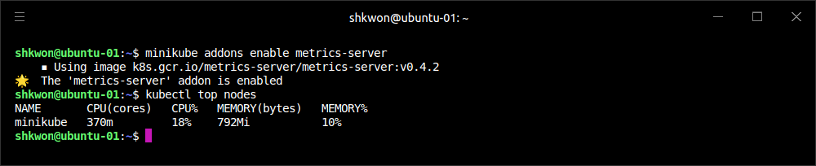
Debugging Commands(3/3)
Getting Resource Usage :
  You can also use the port-forward command with services by specifying services “/<service-name>” instead of “<pod-name>”, but note that if you do port-forward to a service, the requests will only ever be forwarded to a single Pod in that service. They will not go through the service load balancer.
  Finally, if you are interested in how your cluster is using resources, you can use the “top” command to see the list of resources in use by either nodes or Pods :
  will display the total CPU and memory in use by the nodes in terms of both absolute units (e.g., cores) and percentage of available resources (e.g., total number of cores).
  Similarly, the following command will show all Pods and their resource usage. By default it only displays Pods in the current namespace, but you can add the “--all-namespaces” flag to see resource usage by all Pods in the cluster :
  NOTE : Before you run “kubectl top nodes” command, you need to enable “metrics-server” add-on with the following command : “minikube addons enable metric-server”.
kubectl top nodes
kubectl top pods

Slide 13
Command Autocompletion
Autocompletion in Shell Environment :
  The kubectl supports integration with your shell to enable tab completion for both commands and resources. Depending on your environment, you may need to install the “bash-completion” package before you activate command autocompletion. You can do this using the appropriate package manager:
  When installing on MacOS, make sure to follow the instructions from “brew” about how to activate tab completion using your “${HOME}/.bash_profile”.
  Once “bash-completion” is installed, you can temporarily activate it for your terminal using :
  To make this automatic for every terminal, you can add it to your “${HOME}/.bashrc” file :
  If you use “zsh” you can find similar instructions in https://kubernetes.io/docs/tasks/tools/#using-zsh.
# MacOS
brew install bash-completion
# CentOS/Red Hat
yum install bash-completion
# Debian/Ubuntu
apt-get install bash-completion
source <(kubectl completion bash)
echo "source <(kubectl completion bash)" >> ${HOME}/.bashrc

Slide 14
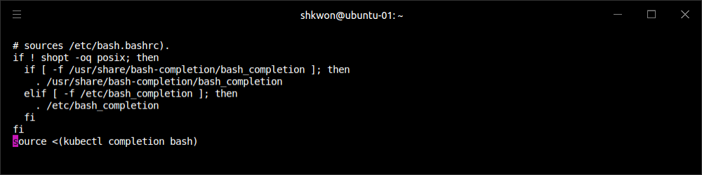
NOTE : Shell Script
Bash Shell Setup :
  You want to find any changes after running the previous command, you can see the “$HOME/.bashrc” file, which will be run by the bash shell when you login.
  As you can see, the last line is added to the “$HOME/.bashrc” file. “source” command will set the bash shell environment with the specified input.

Slide 15



Alternative Ways of Viewing Your Cluster
Plugins and Mobile App :
  In addition to kubectl, there are other tools for interacting with your Kubernetes cluster. For example, there are plug-ins for several editors that integrate Kubernetes and the editor environment, including :
    Visual Studio Code
    IntelliJ
    Eclipse
  Additionally, there is an open source mobile application that allows you to access your cluster from your phone.

Slide 16
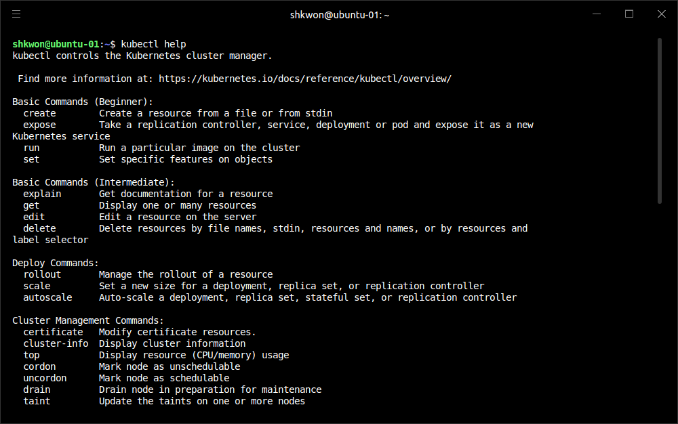
Built-in Help for Kubectl
Help :
  The kubectl has a great deal of built-in help available. You can start viewing this help with :
$ kubectl help
or:
$ kubectl help <command-name>

Slide 17
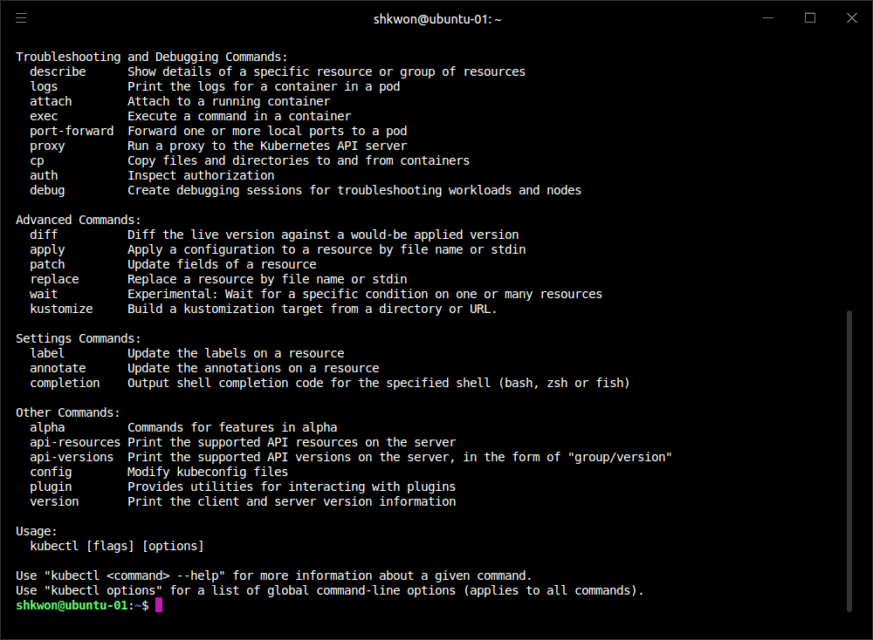
NOTE : Help Message
More on Help Message :
  You can see the following help message after the previous screenshot.

Slide 18
Pods

Slide 19
What is Pods?(1/4)
Colocating Multiple Applications :
  In real-world deployments of containerized applications you will often want to colocate multiple applications into a single atomic unit, scheduled onto a single machine.
  A canonical example of such as the following figure, which consists of a container serving web requests and a container synchronizing the filesystem with a remote Git repository.
  At first, it might seem tempting to wrap up both the web server and the Git synchronizer into a single container. After closer inspection, however, the reasons for the separation become clear. First, the two different containers have significantly different requirements in terms of resource usage. Take, for example, memory. Because the web server is serving user requests, we want to ensure that it is always available and responsive. On the other hand, the Git synchronizer isn’t really user-facing and has a “best effort” quality of service.

Slide 20
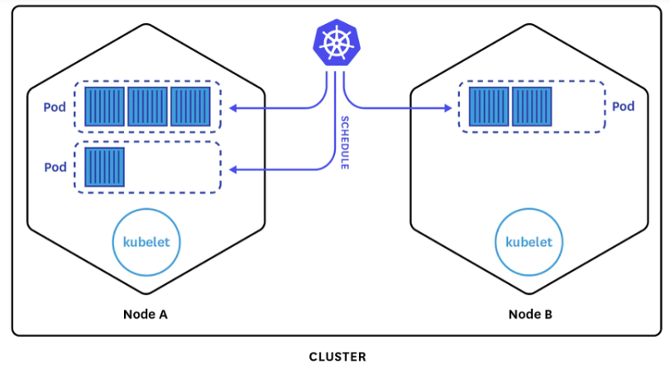
What is Pods?(2/4)
Colocating Multiple Applications :
  Suppose that our Git synchronizer has a memory leak. We need to ensure that the Git synchronizer cannot use up memory that we want to use for our web server, since this can affect web server performance or even crash the server.
  This sort of resource isolation is exactly the sort of thing that containers are designed to accomplish. By separating the two applications into two separate containers, we can ensure reliable web server operation.
  Of course, the two containers are quite symbiotic; it makes no sense to schedule the web server on one machine and the Git synchronizer on another. Consequently, Kubernetes groups multiple containers into a single atomic unit called a Pod*. (The name goes with the whale theme of Docker containers, since a Pod is also a group of whales.)
*Pod : (새·바다표범·고래 등의) 작은 떼.

Slide 21
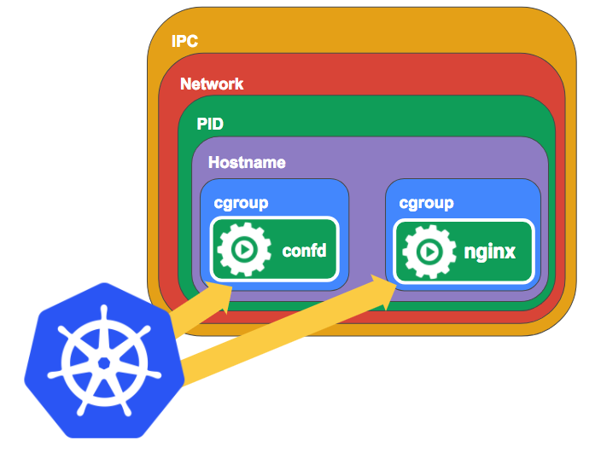
What is Pods?(3/4)
Pods in Kubernetes :
  A Pod represents a collection of application containers and volumes running in the same execution environment. Pods, not containers, are the smallest deployable artifact in a Kubernetes cluster. This means all of the containers in a Pod always land on the same machine.
  Each container within a Pod runs in its own cgroup, but they share a number of Linux namespaces.
  Applications running in the same Pod share the same IP address and port space (network namespace), have the same hostname (UTS : Unix Time Sharing namespace), and can communicate using native interprocess communication channels over System V IPC or POSIX message queues (IPC namespace).
  However, applications in different Pods are isolated from each other; they have different IP addresses, different hostnames, and more. Containers in different Pods running on the same node might as well be on different servers.

Slide 22
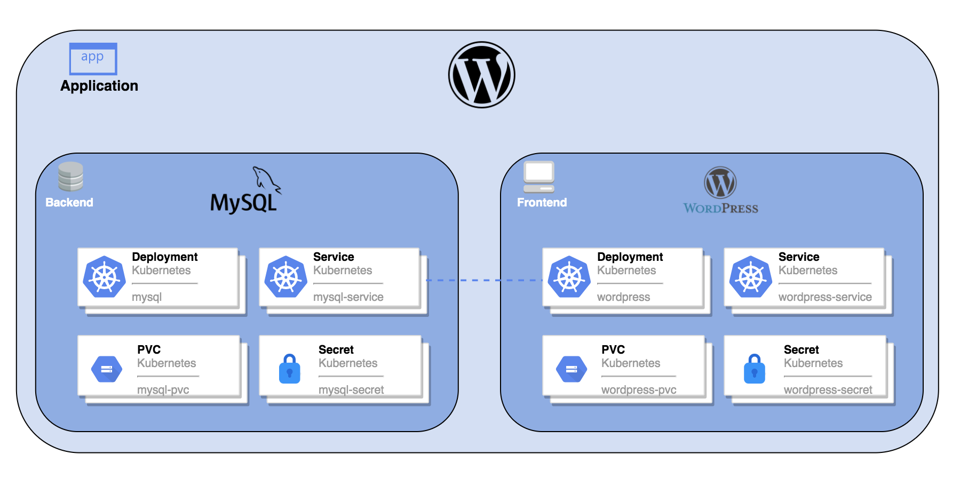
What is Pods?(4/4)
Thinking with Pods :
  One of the most common questions that occurs in the adoption of Kubernetes is “What should I put in a Pod?”.
  Sometimes people see Pods and think, “Aha! A WordPress container and a MySQL database container should be in the same Pod.” However, this kind of Pod is actually an example of an anti-pattern for Pod construction. There are two reasons for this. First, WordPress and its database are not truly symbiotic. If the WordPress container and the database container land on different machines, they still can work together quite effectively, since they communicate over a network connection. Secondly, you don’t necessarily want to scale WordPress and the database as a unit. WordPress itself is mostly stateless, and thus you may want to scale your WordPress frontends in response to frontend load by creating more WordPress Pods. Scaling a MySQL database is much trickier, and you would be much more likely to increase the resources dedicated to a single MySQL Pod. If you group the WordPress and MySQL containers together in a single Pod, you are forced to use the same scaling strategy for both containers, which doesn’t fit well.
  In general, the right question to ask yourself when designing Pods is, “Will these containers work correctly if they land on different machines?” If the answer is “no,” a Pod is the correct grouping for the containers. If the answer is “yes,” multiple Pods is probably the correct solution.

Slide 23
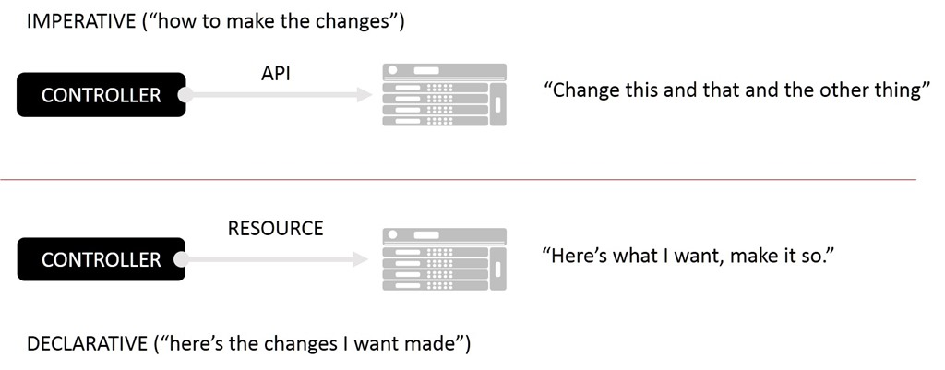
The Pod Manifest(1/5)
Declarative Configuration :
  Pods are described in a Pod manifest*. The Pod manifest is just a text-file representation of the Kubernetes API object. Kubernetes strongly believes in declarative configuration. Declarative configuration means that you write down the desired state of the world in a configuration and then submit that configuration to a service that takes actions to ensure the desired state becomes the actual state.
Declarative configuration is different from imperative configuration, where you simply take a series of actions (e.g., apt-get install foo) to modify the world. Years of production experience have taught us that maintaining a written record of the system’s desired state leads to a more manageable, reliable system.
Declarative configuration enables numerous advantages, including code review for configurations as well as documenting the current state of the world for distributed teams. Additionally, it is the basis for all of the self-healing behaviors in Kubernetes that keep applications running without user action.
*manifest : 선박 적하 목록, 승객명단

Slide 24
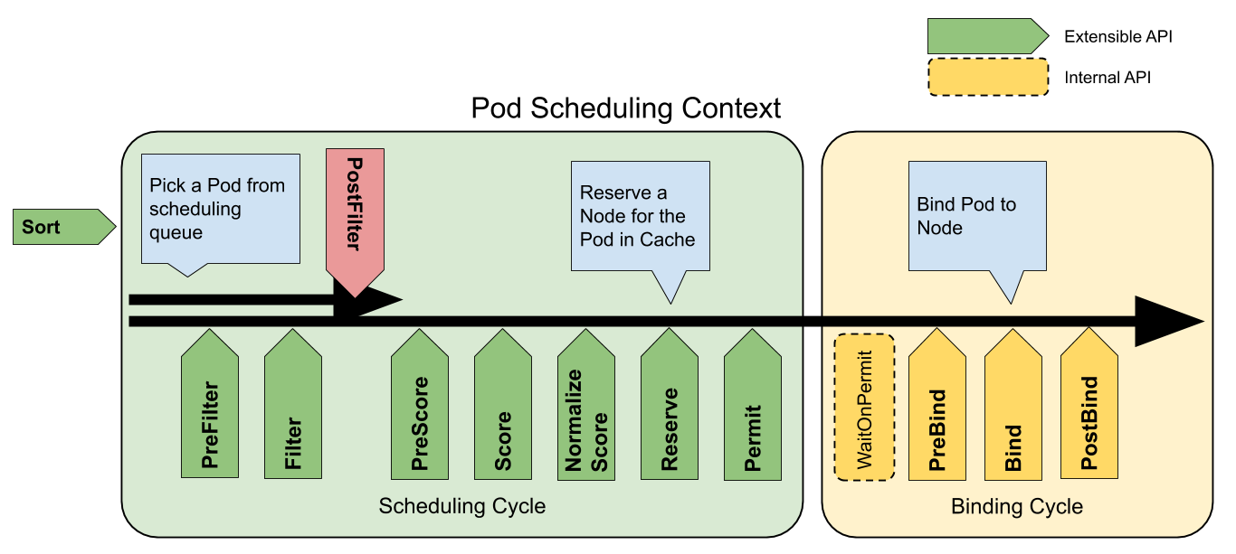
The Pod Manifest(2/5)
Pod Scheduling :
  The Kubernetes API server accepts and processes Pod manifests before storing them in persistent storage (etcd*). The scheduler also uses the Kubernetes API to find Pods that haven’t been scheduled to a node. The scheduler then places the Pods onto nodes depending on the resources and other constraints expressed in the Pod manifests.
  Multiple Pods can be placed on the same machine as long as there are sufficient resources. However, scheduling multiple replicas of the same application onto the same machine is worse for reliability, since the machine is “a single failure domain(A single point of failure)”. Consequently, the Kubernetes scheduler tries to ensure that Pods from the same application are distributed onto different machines for reliability in the presence of such failures. Once scheduled to a node, Pods don’t move and must be explicitly destroyed and rescheduled.
  Multiple instances of a Pod can be deployed by repeating the workflow. However, ReplicaSets are better suited for running multiple instances of a Pod. (It turns out they’re also better at running a single Pod.)
* etcd(엣시디)는 리눅스의 구성 정보를 주로 가지고 있는 etc 디렉터리와 distributed의 합성어

Slide 25
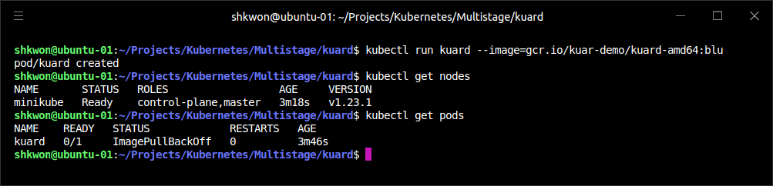
The Pod Manifest(3/5)
Creating a Pod :
  The simplest way to create a Pod is via the imperative “kubectl run” command. For example, to run our same kuard server, use :
  You can see the status of this Pod by running “kubectl get pods” command. You may initially see the container as Pending, but eventually you will see it transition to Running, which means that the Pod and its containers have been successfully created.
  NOTE : Here you can see “ImagePullBackOff” in “STATUS” from “kubectl get pods” command output. It means there is no image for the “--image=xxx” option in “kubectl run” command. In order to fix this problem, you need to make docker image or pull the image from the docker hub repository.
$ minikube start
$ kubectl run kuard --image=knix008/kuard-shkwon-amd64:1.0
$ kubectl get pods

Slide 26
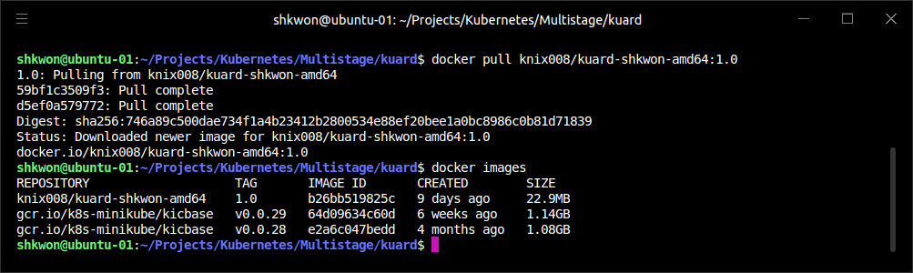
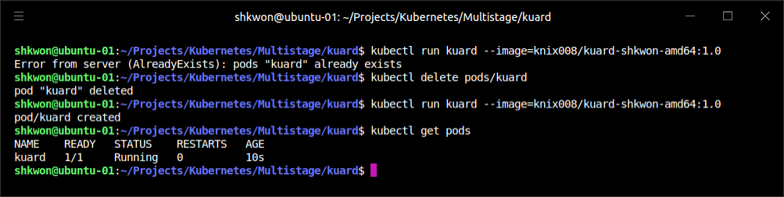
NOTE : Fixing “ImagePullBackOff” Error
Pull the Image from Docker Hub :
  In previous presentation, we build “kuard” image and push it into Docker Hub. Now it’s time to pull the image.

Slide 27
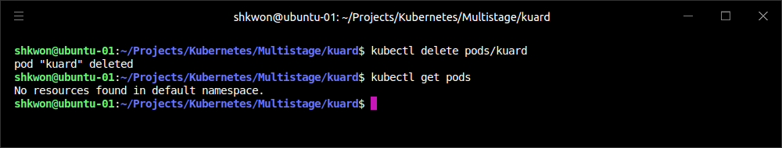
The Pod Manifest(4/5)
Removing a Pod :
  For now, you can delete a Pod by running “kubectl delete” command :
$ kubectl delete pods/kuard

Slide 28
The Pod Manifest(5/5)
Creating a Pod Manifest :
  Pod manifests can be written using YAML(YAML Ain't Markup Language) or JSON(JavaScript Object Notation), but YAML is generally preferred because it is slightly more human-editable and has the ability to add comments. Pod manifests (and other Kubernetes API objects) should really be treated in the same way as source code, and things like comments help explain the Pod to new team members who are looking at them for the first time.
  Pod manifests include a couple of key fields and attributes: namely a metadata section for describing the Pod and its labels, a spec section for describing volumes, and a list of containers that will run in the Pod.
  To run the docker image, we already used the following command :
  A similar result can be achieved by instead writing the following codes to a file named “kuard-pod.yaml” and then using “kubectl” commands to load that manifest to Kubernetes.
docker run -d --name kuard --publish 8080:8080 knix008/kuard-shkwon-amd64:1.0
apiVersion: v1
kind: Pod
metadata:
name: kuard
spec:
containers:
- image: knix008/kuard-shkwon-amd64:1.0
name: kuard
ports:
- containerPort: 8080
name: http
protocol: TCP

Slide 29
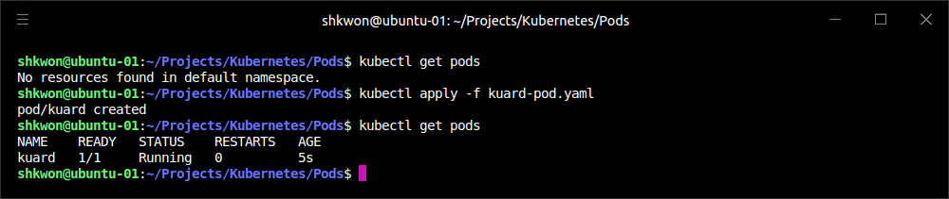
Running Pods(1/6)
Launching :
  Use the “kubectl apply” command to launch a single instance of “kuard” :
  The Pod manifest will be submitted to the Kubernetes API server. The Kubernetes system will then schedule that Pod to run on a healthy node in the cluster, where it will be monitored by the “kubelet daemon process”.
$ kubectl apply -f kuard-pod.yaml

Slide 30
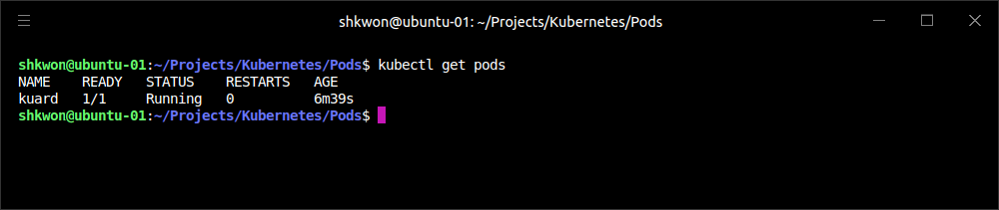
Running Pods(2/6)
Listing Pods :
  Using the “kubectl” command-line tool, we can list all Pods running in the cluster. For now, this should only be the single Pod that we created in the previous step :
  You can see the name of the Pod (“kuard”) that we gave it in the previous YAML file. In addition to the number of ready containers (1/1), the output also shows the status, the number of times the Pod was restarted, as well as the age of the Pod. If you ran this command immediately after the Pod was created, you might see “Pending” in the status field.
  The Pending state indicates that the Pod has been submitted but hasn’t been scheduled yet.
$ kubectl get pods

Slide 31
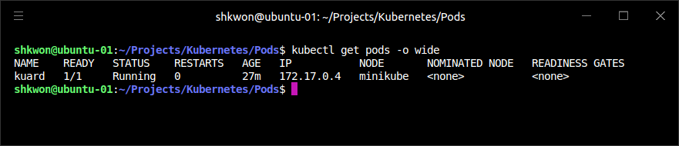
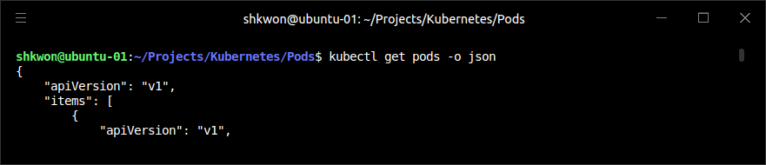
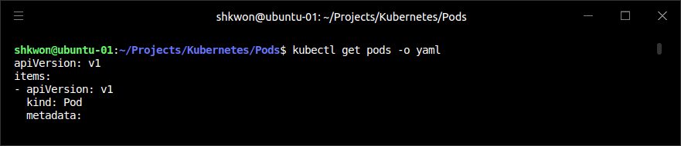
Running Pods(3/6)
Listing Pods :
  If a more significant error occurs (e.g., an attempt to create a Pod with a container image that doesn’t exist like “ImagePullBackOff”), it will also be listed in the status field.
  By default, the kubectl command-line tool tries to be concise in the information it reports, but you can get more information via command-line flags. Adding “-o wide” to any kubectl command will print out slightly more information (while still trying to keep the information to a single line). Adding “-o json” or “-o yaml” will print out the complete objects in JSON or YAML, respectively.

Slide 32
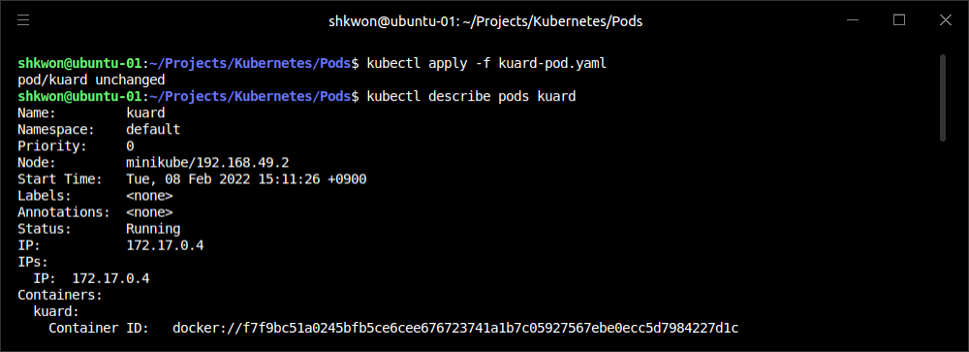
Running Pods(4/6)
Pod Details :
  Kubernetes maintains numerous events about Pods that are present in the event stream, not attached to the Pod object. To find out more information about a Pod (or any Kubernetes object) you can use the “kubectl describe” command. For example, to describe the Pod we previously created, you can run :
$ kubectl describe pods kuard

Slide 33
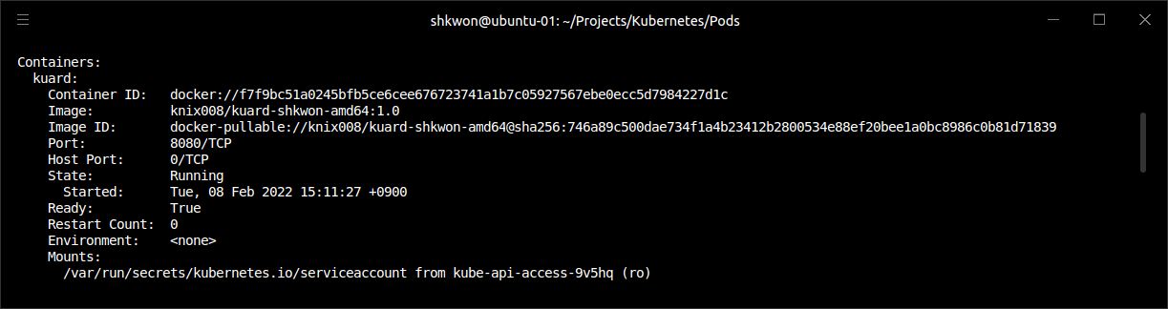
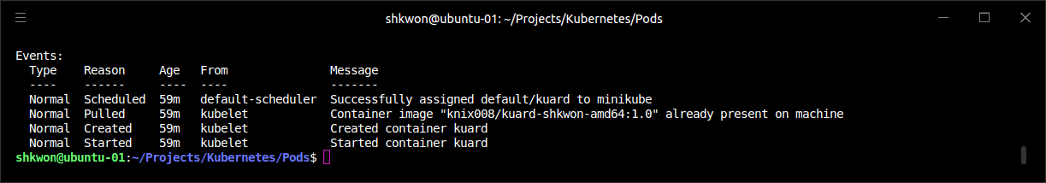
Running Pods(5/6)
Pod Details :
  Then there is information about the containers running in the Pod :
  Finally, there are events related to the Pod, such as when it was scheduled, when its image was pulled, and if/when it had to be restarted because of failing health checks :

Slide 34
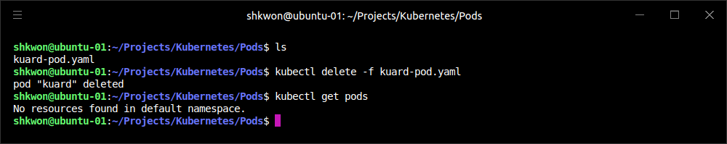
Running Pods(6/6)
Deleting a Pod :
  When it is time to delete a Pod, you can delete it either by name or using the same file that you used to create it :
  When a Pod is deleted, it is not immediately killed. Instead, if you run “kubectl get pods” you will see that the Pod is in the Terminating state. All Pods have a termination grace period. By default, this is 30 seconds. When a Pod is transitioned to Terminating it no longer receives new requests. In a serving scenario, the grace period is important for reliability because it allows the Pod to finish any active requests that it may be in the middle of processing before it is terminated.
  It’s important to note that when you delete a Pod, any data stored in the containers associated with that Pod will be deleted as well. If you want to persist data across multiple instances of a Pod, you need to use “PersistentVolumes.”
$ kubectl delete pods/kuard
or
$ kubectl delete -f kuard-pod.yaml

Slide 35
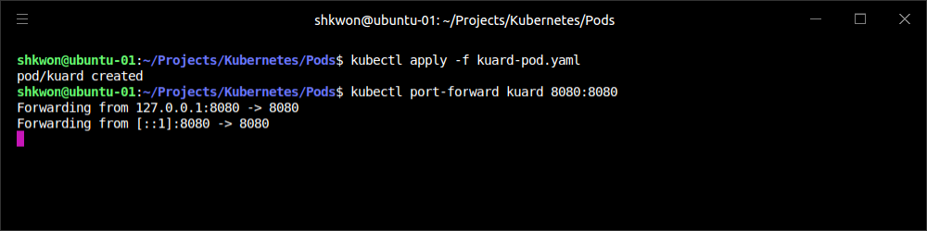
Accessing Your Pod(1/5)
Get Data from the Running Pod :
  Now that your Pod is running, you’re going to want to access it for a variety of reasons. You may want to load the web service that is running in the Pod. You may want to view its logs to debug a problem that you are seeing, or even execute other commands in the context of the Pod to help debug.
Using Port Forwarding :
  To access a specific Pod, you can use the port-forwarding support built into the Kubernetes API and command-line tools. When you run :
  A secure tunnel is created from your local machine, through the Kubernetes master, to the instance of the Pod running on one of the worker nodes. As long as the port-forward command is still running, you can access the Pod (in this case the “kuard” web interface) at http://localhost:8080.
$ kubectl port-forward kuard 8080:8080

Slide 36
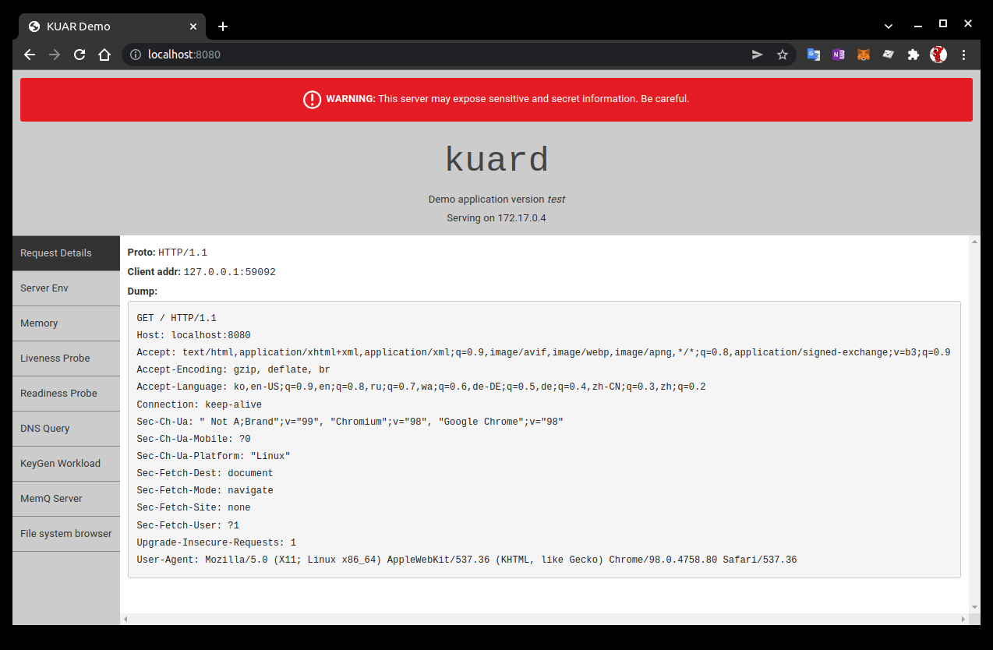
NOTE : Accessing a Running Pod
Port-Forwarding :
  Access the running Pod using a web browser : http://localhost:8080

Slide 37
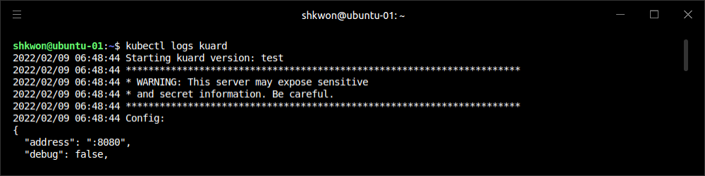
Accessing Your Pod(2/5)
Getting More Info with Logs :
  When your application needs debugging, it’s helpful to be able to dig deeper than describe to understand what the application is doing. Kubernetes provides two commands for debugging running containers. The “kubectl logs” command downloads the current logs from the running instance :
  Adding the “-f” flag will cause you to continuously stream logs. The “kubectl logs” command always tries to get logs from the currently running container. Adding the “--previous” flag will get logs from a previous instance of the container. This is useful, for example, if your containers are continuously restarting due to a problem at container startup.
$ kubectl logs kuard

Slide 38
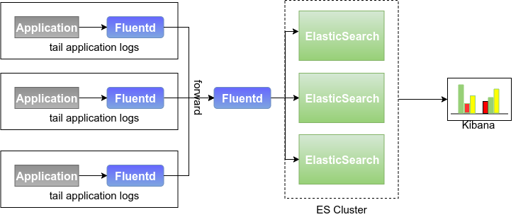
Accessing Your Pod(3/5)
Getting More Info with Logs :
  NOTE : While using “kubectl logs” is useful for one-off debugging of containers in production environments, it’s generally useful to use a log aggregation service. There are several open source log aggregation tools, like “fluentd” and “elasticsearch”, as well as numerous cloud logging providers. Log aggregation services provide greater capacity for storing a longer duration of logs, as well as rich log searching and filtering capabilities. Finally, they often provide the ability to aggregate logs from multiple Pods into a single view.

Slide 39
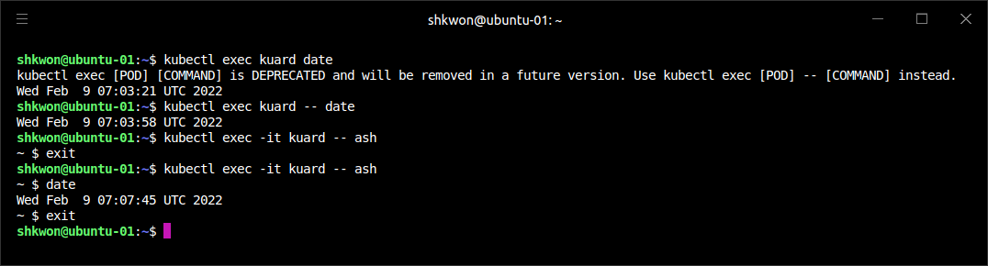
Accessing Your Pod(4/5)
Running Commands in Your Container with “exec” :
  Sometimes logs are insufficient, and to truly determine what’s going on you need to execute commands in the context of the container itself. To do this you can use :
  You can also get an interactive session by adding the “-it”(Interactive) flags :
$ kubectl exec kuard date
or
$ kubectl exec kuard -- date
$ kubectl exec -it kuard -- ash

Slide 40
Accessing Your Pod(5/5)
Copying Files to and from Containers :
  At times you may need to copy files from a remote container to a local machine for more in-depth exploration. For example, you can use a tool like “Wireshark” to visualize “tcpdump” packet captures. Suppose you had a file called “/captures/capture3.txt” inside a container in your Pod. You could securely copy that file to your local machine by running :
  Other times you may need to copy files from your local machine into a container. Let’s say you want to copy “$HOME/config.txt” to a remote container. In this case, you can run :
  Generally speaking, copying files into a container is an “anti-pattern”. You really should treat the contents of a container as “immutable”. But occasionally it’s the most immediate way to stop the bleeding and restore your service to health, since it is quicker than building, pushing, and rolling out a new image. Once the bleeding is stopped, however, “it is critically important that you immediately go and do the image build and rollout, or you are guaranteed to forget the local change that you made to your container and overwrite it in the subsequent regularly scheduled rollout”.
$ kubectl cp <pod-name>:/captures/capture3.txt ./capture3.txt
$ kubectl cp $HOME/config.txt <pod-name>:/config.txt

Slide 41
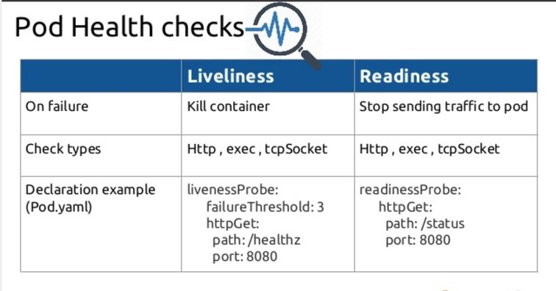
Health Checks(1/7)
Liveness Health Checks :
  When you run your application as a container in Kubernetes, it is automatically kept alive for you using a process health check. This health check simply ensures that the main process of your application is always running. If it isn’t, Kubernetes restarts it.
  However, in most cases, a simple process check is insufficient. For example, if your process has deadlocked and is unable to serve requests, a process health check will still believe that your application is healthy since its process is still running.
  To address this, Kubernetes introduced “health checks” for application liveness. “Liveness health checks” run application-specific logic (e.g., loading a web page) to verify that the application is not just still running, but is functioning properly. Since these liveness health checks are application-specific, you have to define them in your “Pod manifest”.

Slide 42
Health Checks(2/7)
Liveness Probe :
  Once the “kuard” process is up and running, we need a way to confirm that it is actually healthy and shouldn’t be restarted. “Liveness probes are defined per container”, which means each container inside a Pod is health-checked separately.
  Here we add a “liveness probe” to our “kuard” container, which runs an HTTP request against the “/healthy” path on our container.
apiVersion: v1
kind: Pod
metadata:
name: kuard
spec:
containers:
- image: gcr.io/kuar-demo/kuard-amd64:blue
name: kuard
livenessProbe:
httpGet:
path: /healthy
port: 8080
initialDelaySeconds: 5
timeoutSeconds: 1
periodSeconds: 10
failureThreshold: 3
ports:
- containerPort: 8080
name: http
protocol: TCP

Slide 43
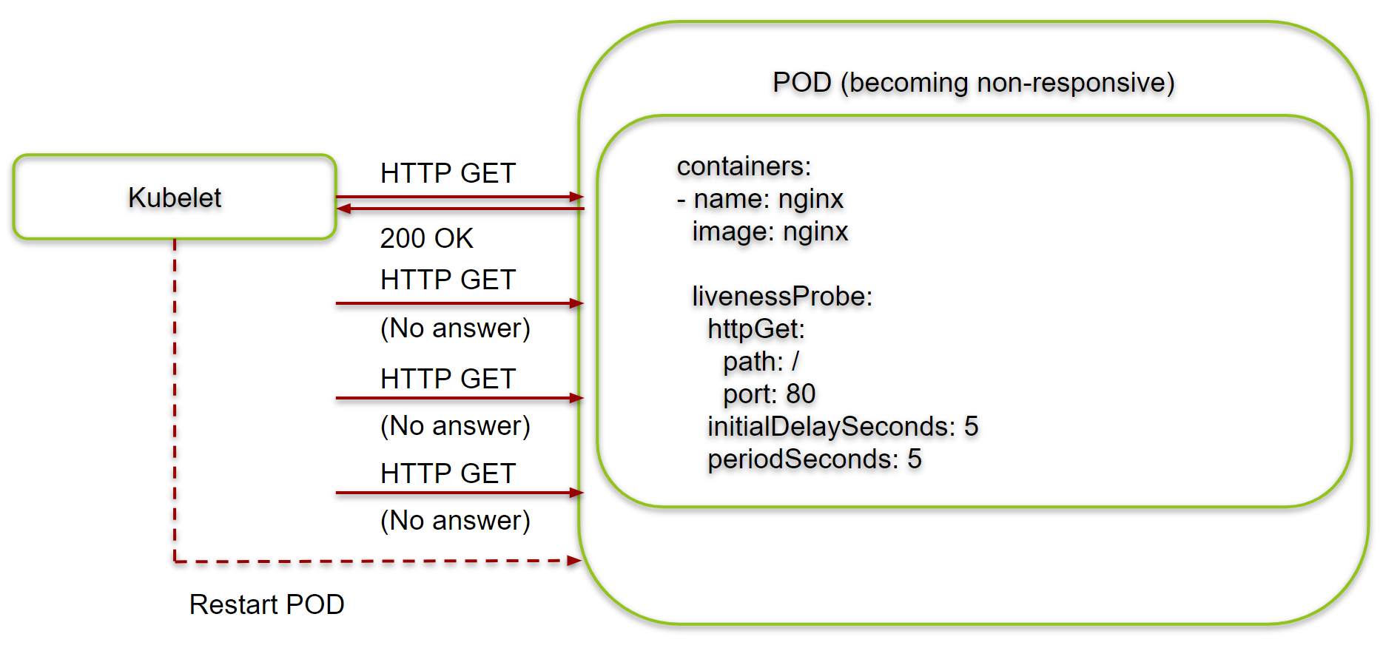
Health Checks(3/7)
Liveness Probe :
  The preceding Pod manifest uses an “httpGet” probe to perform an HTTP GET request against the “/healthy” endpoint on port “8080” of the “kuard” container. The probe sets an “initialDelaySeconds” of 5, and thus will not be called until 5 seconds after all the containers in the Pod are created. The probe must respond within the 1-second timeout(“timeoutSeconds”), and “the HTTP status code must be equal to or greater than 200 and less than 400 to be considered successful”. Kubernetes will call the probe every 10 seconds(“periodSeconds”). If more than three consecutive probes fail(“failureThreshold”), the container will fail and restart.

Slide 44
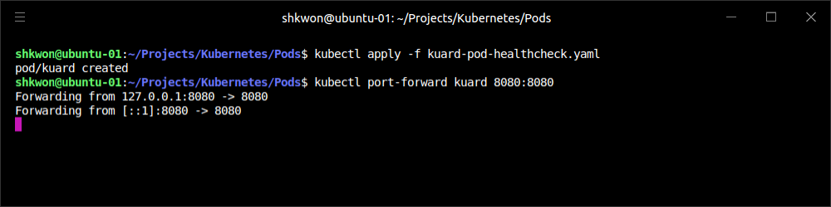
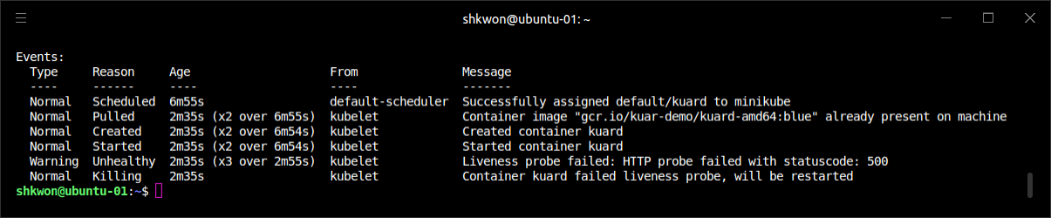
Health Checks(4/7)
Liveness Probe :
  You can see this in action by looking at the “kuard” status page. Create a Pod using this manifest and then “port-forward” to that Pod :
  Point your browser to “http://localhost:8080”. Click the “Liveness Probe” tab. You should see a table that lists all of the probes that this instance of “kuard” has received. If you click the “Fail” link on that page, “kuard” will start to fail health checks. Wait long enough and Kubernetes will restart the container. At that point the display will reset and start over again. Details of the restart can be found with “kubectl describe pods kuard”. The “Events” section will have text similar to the following :
$ kubectl delete pods/kuard
$ kubectl apply -f kuard-pod-healthcheck.yaml
$ kubectl port-forward kuard 8080:8080

Slide 45
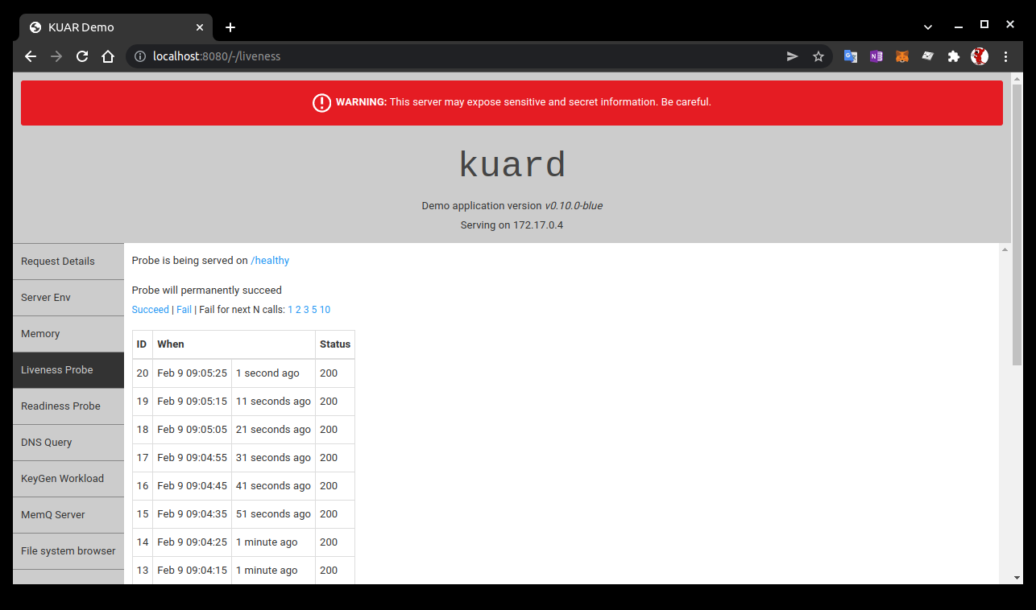
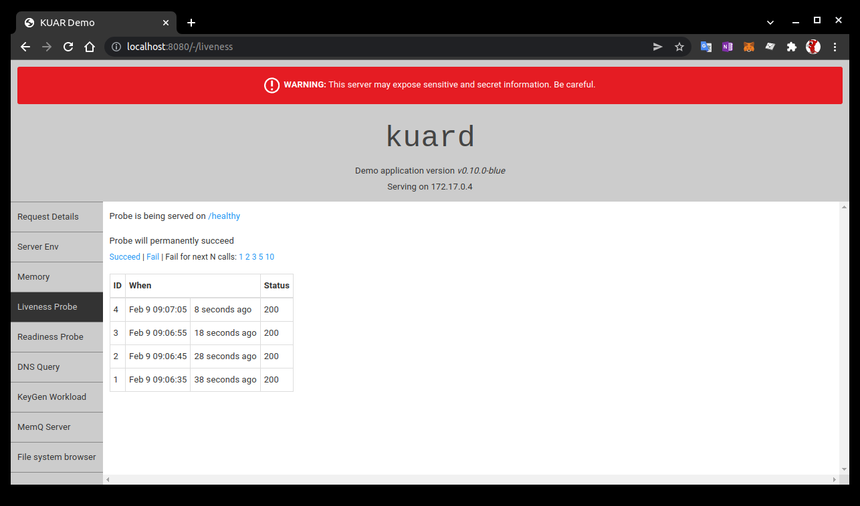

NOTE : Liveness Probe Example
Accessing “kuard” :
  Go to “Liveness Probe” tab and click “fail” link.

Slide 46
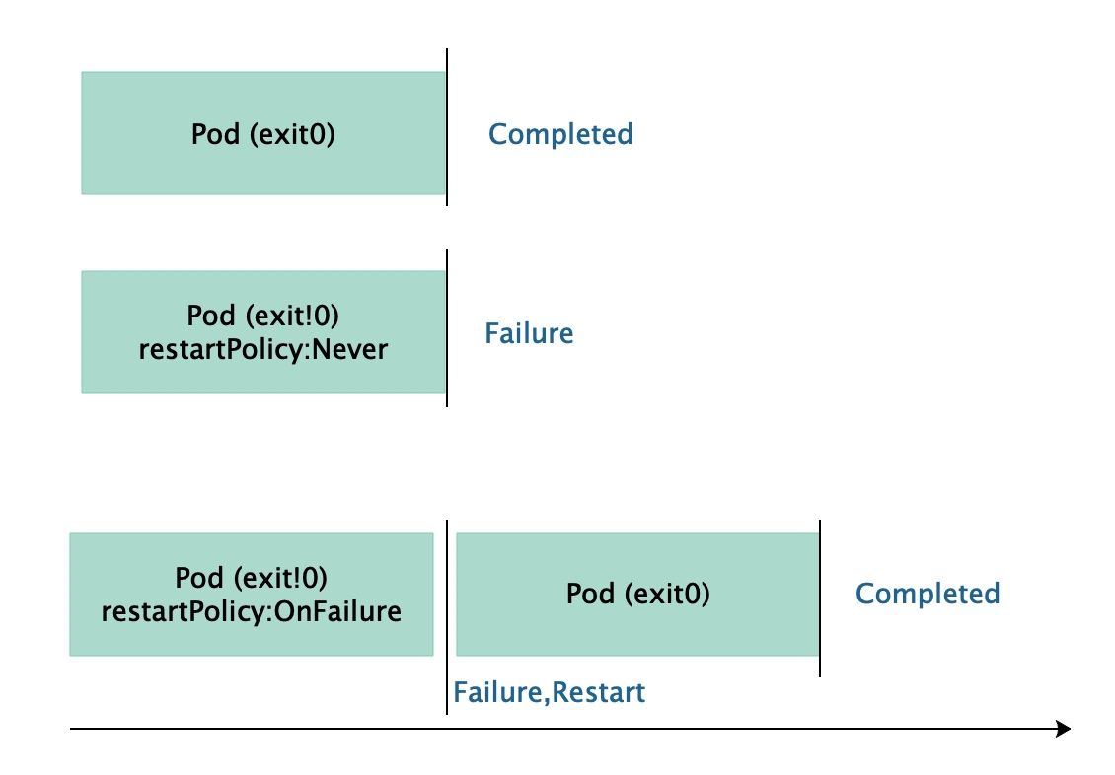
Health Checks(5/7)
Liveness Probe :
  NOTE : While the default response to a failed liveness check is to restart the Pod, the actual behavior is governed by the Pod’s “restartPolicy”. There are three options for the restart policy: Always (the default), OnFailure (restart only on liveness failure or nonzero process exit code), or Never.

Slide 47
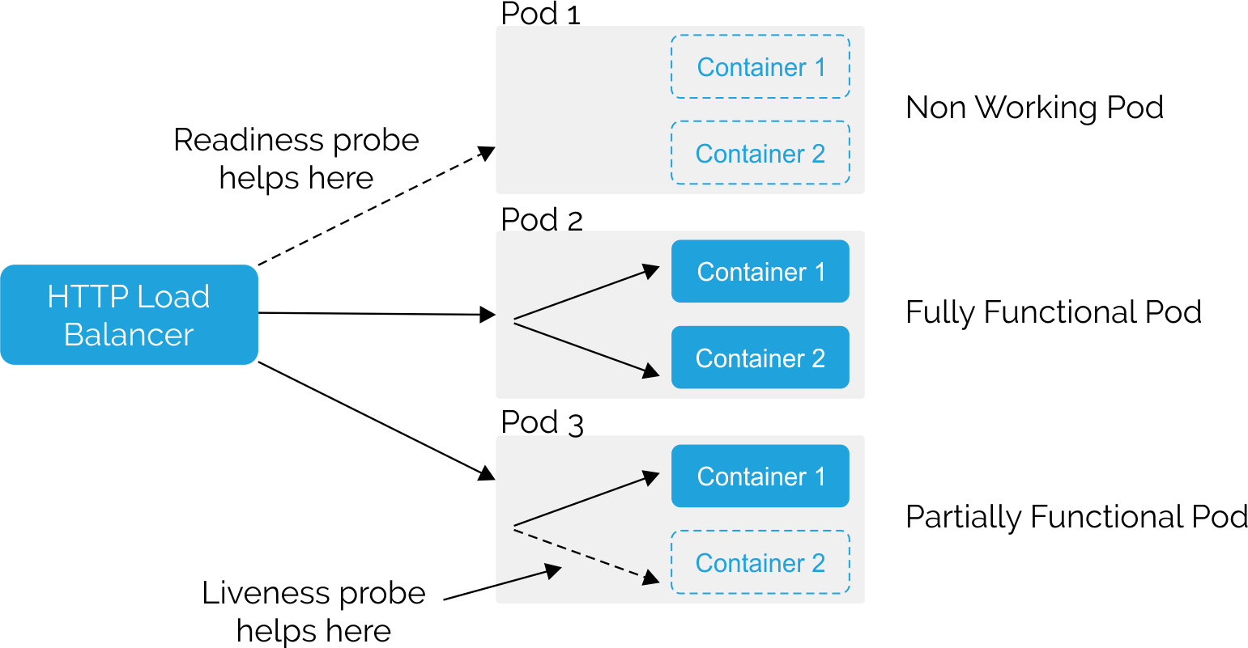
Health Checks(6/7)
Readiness Probe :
  Of course, liveness isn’t the only kind of health check we want to perform. Kubernetes makes a distinction between liveness and readiness. Liveness determines if an application is running properly. Containers that fail liveness checks are restarted. Readiness describes when a container is ready to serve user requests.
  Containers that fail readiness checks are removed from service load balancers. Readiness probes are configured similarly to liveness probes. Combining the readiness and liveness probes helps ensure only healthy containers are running within the cluster.

Slide 48
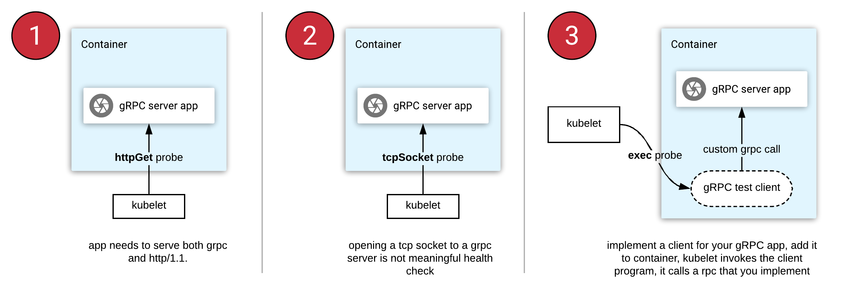
Health Checks(7/7)
Types of Health Checks :
  In addition to HTTP checks, Kubernetes also supports “tcpSocket” health checks that open a TCP socket; if the connection is successful, the probe succeeds. This style of probe is useful for “non-HTTP applications”; for example, databases or other non–HTTP-based APIs.
  Finally, Kubernetes allows “exec” probes. These execute a script or program in the context of the container. Following typical convention, if this script returns “a zero exit code”, the probe succeeds; otherwise, it fails. exec scripts are often useful for custom application validation logic that doesn’t fit neatly into an HTTP call.

Slide 49
Resource Management(1/5)
Increasing the Utilization :
  Most people move into containers and orchestrators like Kubernetes because of the radical improvements in image packaging and reliable deployment they provide. In addition to application-oriented primitives that simplify distributed system development, equally important is the ability to increase the overall utilization of the compute nodes that make up the cluster.
  The basic cost of operating a machine, either virtual or physical, is basically constant regardless of whether it is idle or fully loaded. Consequently, ensuring that these machines are maximally active increases the efficiency of every dollar spent on infrastructure.
  Generally speaking, we measure this efficiency with the utilization metric. Utilization is defined as the amount of a resource actively being used divided by the amount of a resource that has been purchased. For example, if you purchase a one-core machine, and your application uses one-tenth of a core, then your utilization is 10%. With “scheduling systems” like Kubernetes managing resource packing, you can drive your utilization to greater than 50%.
  To achieve this, you have to tell Kubernetes about the resources your application requires, so that Kubernetes can find the optimal packing of containers onto purchased machines.
  Kubernetes allows users to specify two different resource metrics. Resource requests specify the minimum amount of a resource required to run the application. Resource limits specify the maximum amount of a resource that an application can consume.

Slide 50
Resource Management(2/5)
Resource Requests : Minimum Required Resources
  With Kubernetes, a Pod requests the resources required to run its containers. Kubernetes guarantees that these resources are available to the Pod. The most commonly requested resources are CPU and memory, but Kubernetes has support for other resource types as well, such as GPUs and more.
  NOTE : Resources are requested per container, not per Pod. The total resources requested by the Pod is the sum of all resources requested by all containers in the Pod. The reason for this is that in many cases the different containers have very different CPU requirements. For example, in the web server and data synchronizer Pod, the web server is user-facing and likely needs a great deal of CPU, while the data synchronizer can make do with very little.
apiVersion: v1
kind: Pod
metadata:
name: kuard
spec:
containers:
- image: knix008/kuard-shkwon-amd64:1.0
name: kuard
resources:
requests:
cpu: "500m"
memory: "128Mi"
ports:
- containerPort: 8080
name: http
protocol: TCP

Slide 51
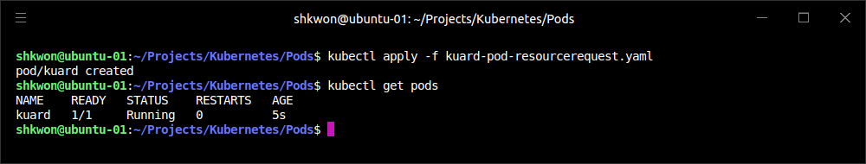
NOTE : Running Pod Manifest
The Result :
  To run the Pod manifest, you need to run “minikube start” command first. After that run “kubectl apply -f” command.
$ minikube start
$ kubectl apply -f kuard-pod-resourcerequest.yaml

Slide 52
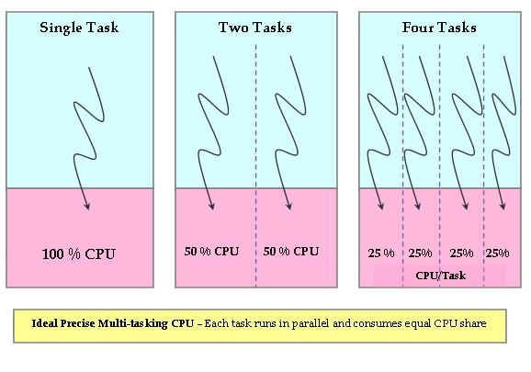
Resource Management(3/5)
Request Limit :
  Requests are used when scheduling Pods to nodes. The Kubernetes scheduler will ensure that the sum of all requests of all Pods on a node does not exceed the capacity of the node. Therefore, a Pod is guaranteed to have at least the requested resources when running on the node. Importantly, “request” specifies a minimum. It does not specify a maximum cap on the resources a Pod may use.
  For example, imagine that we have container whose code attempts to use all available CPU cores. Suppose that we create a Pod with this container that requests 0.5 CPU. Kubernetes schedules this Pod onto a machine with a total of 2 CPU cores. As long as it is the only Pod on the machine, it will consume all 2.0 of the available cores, despite only requesting 0.5 CPU. If a second Pod with the same container and the same request of 0.5 CPU lands on the machine, then each Pod will receive 1.0 cores. If a third identical Pod is scheduled, each Pod will receive 0.66 cores. Finally, if a fourth identical Pod is scheduled, each Pod will receive the 0.5 core it requested, and the node will be at capacity. CPU requests are implemented using the “cpu-shares” functionality in the Linux kernel.

Slide 53
Resource Management(4/5)
Request Limit :
  NOTE : Memory requests are handled similarly to CPU, but there is an important difference. If a container is over its memory request, the OS can’t just remove memory from the process, because it’s been allocated. Consequently, when the system runs out of memory, the “kubelet” terminates containers whose memory usage is greater than their requested memory. These containers are automatically restarted, but with less available memory on the machine for the container to consume.
  Since resource requests guarantee resource availability to a Pod, they are critical to ensuring that containers have sufficient resources in high-load situations.

Slide 54
Resource Management(5/5)
Capping Resource Usage with Limits :
  In addition to setting the resources required by a Pod, which establishes the minimum resources available to the Pod, you can also set a maximum on a Pod’s resource usage via resource limits.
  When you establish limits on a container, the kernel is configured to ensure that consumption cannot exceed these limits. A container with a CPU limit of 0.5 cores will only ever get 0.5 cores(500m), even if the CPU is otherwise idle. A container with a memory limit of 256 MB will not be allowed additional memory (e.g., “malloc : memory allocation” will fail) if its memory usage exceeds 256 MB.
apiVersion: v1
kind: Pod
metadata:
name: kuard
spec:
containers:
- image: knix008/kuard-shkwon-amd64:1.0
name: kuard
resources:
requests:
cpu: "500m"
memory: "128Mi"
limits:
cpu: "1000m"
memory: "256Mi"
ports:
- containerPort: 8080
name: http
protocol: TCP

Slide 55
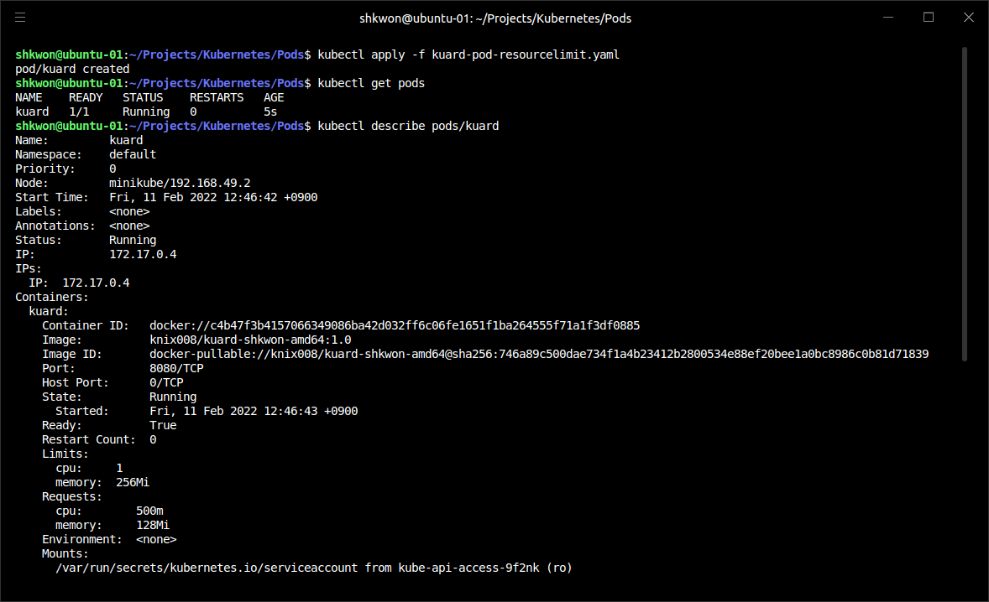
NOTE : Running Pod Manifest
The Result :
  We assume that you are running “minikube” now. Use “kubectl apply -f xxx.yaml” and “kubectl describe pods/xxx” commands. To remove pod, use “kubectl delete pods/xxx” command.

Slide 56
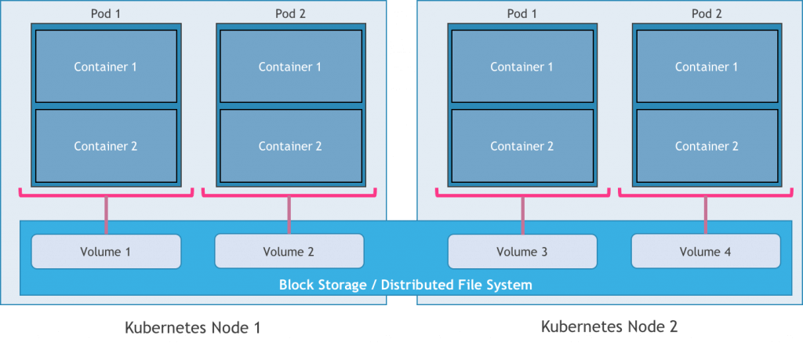
Persisting Data with Volumes(1/5)
Volume :
  When a Pod is deleted or a container restarts, any and all data in the container’s filesystem is also deleted. This is often a good thing, since you don’t want to leave around cruft* that happened to be written by your stateless web application. In other cases, having access to persistent disk storage is an important part of a healthy application. Kubernetes models such persistent storage(volume).
* Cruft : 불필요하거나 쓸모 없이 남은 코드나 데이터

Slide 57
Persisting Data with Volumes(2/5)
Using Volumes with Pods :
  To add a volume to a Pod manifest, there are two new stanzas(room) to add to our configuration. The first is a new spec.volumes section. This array defines all of the volumes that may be accessed by containers in the Pod manifest. It’s important to note that not all containers are required to mount all volumes defined in the Pod. The second addition is the volumeMounts array in the container definition. This array defines the volumes that are mounted into a particular container, and the path where each volume should be mounted.
  Note that two different containers in a Pod can mount the same volume at different mount paths.
apiVersion: v1
kind: Pod
metadata:
name: kuard
spec:
volumes:
- name: "kuard-data"
hostPath:
path: "/var/lib/kuard"
containers:
- image: knix008/kuard-shkwon-amd64:1.0
name: kuard
volumeMounts:
- mountPath: "/data"
name: "kuard-data"
ports:
- containerPort: 8080
name: http
protocol: TCP

Slide 58
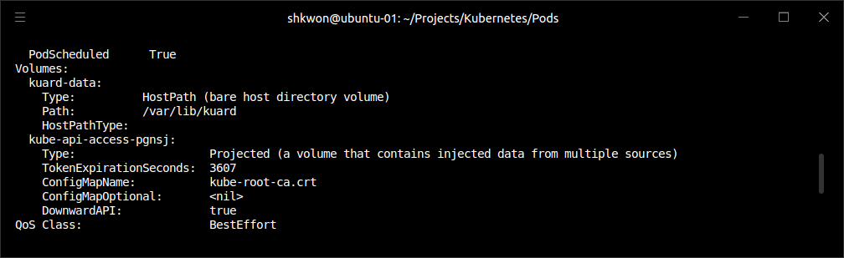
NOTE : Running Pod Manifest
The Result :
  We assume that you are running “minikube” now. Use “kubectl apply -f xxx.yaml” and “kubectl describe pods/xxx” commands. To remove pod, use “kubectl delete pods/xxx” command.
$ kubectl apply -f kuard-pod-volume.yaml
$ kubectl describe pods/kuard

Slide 59
Persisting Data with Volumes(3/5)
Different Ways of Using Volumes with Pods :
  Communication/synchronization - In the first example of a Pod, we saw how two containers used a shared volume to serve a site while keeping it synchronized to a remote Git location. To achieve this, the Pod uses an “emptyDir” volume. Such a volume is scoped to the Pod’s lifespan, but it can be shared between two containers, forming the basis for communication between our Git sync and web serving containers.
  Cache - An application may use a volume that is valuable for performance, but not required for correct operation of the application. For example, perhaps the application keeps prerendered thumbnails of larger images. Of course, they can be reconstructed from the original images, but that makes serving the thumbnails more expensive. You want such a cache to survive a container restart due to a health-check failure, and thus “emptyDir” works well for the cache use case as well.

Slide 60
Persisting Data with Volumes(4/5)
Different Ways of Using Volumes with Pods :
  Persistent data - Sometimes you will use a volume for truly persistent data—data that is independent of the lifespan of a particular Pod, and should move between nodes in the cluster if a node fails or a Pod moves to a different machine for some reason. To achieve this, Kubernetes supports a wide variety of remote network storage volumes, including widely supported protocols like NFS and iSCSI as well as cloud provider network storage like Amazon’s Elastic Block Store, Azure’s Files and Disk Storage, as well as Google’s Persistent Disk.
  Mounting the host filesystem - Other applications don’t actually need a persistent volume, but they do need some access to the underlying host filesystem. For example, they may need access to the “/dev” filesystem in order to perform raw block-level access to a device on the system. For these cases, Kubernetes supports the “hostPath” volume, which can mount arbitrary locations on the worker node into the container.

Slide 61
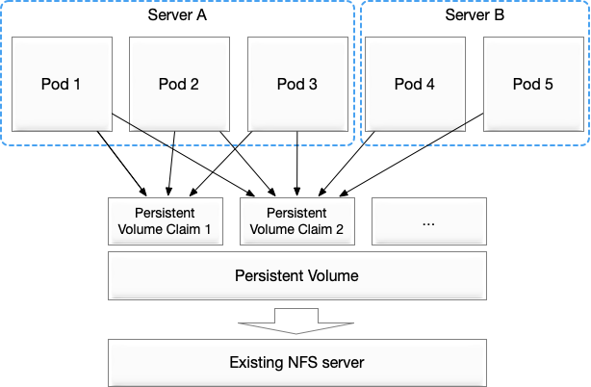
Persisting Data with Volumes(5/5)
Persisting Data Using Remote Disks :
  Oftentimes, you want the data a Pod is using to stay with the Pod, even if it is restarted on a different host machine. To achieve this, you can mount a remote network storage volume into your Pod. When using network-based storage, Kubernetes automatically mounts and unmounts the appropriate storage whenever a Pod using that volume is scheduled onto a particular machine.
  Kubernetes includes support for standard protocols such as NFS(Network File System) and iSCSI(Internet SCSI) as well as cloud provider–based storage APIs for the major cloud providers (both public and private). In many cases, the cloud providers will also create the disk for you if it doesn’t already exist.
  Here is an example of using an NFS server :
...
# Rest of pod definition above here
volumes:
- name: "kuard-data"
nfs:
server: my.nfs.server.local
path: "/exports“
…

Slide 62
Putting It All Together
Running Reliable and Stateful Applications :
  Many applications are stateful, and as such we must preserve any data and ensure access to the underlying storage volume regardless of what machine the application runs on. This can be achieved using a persistent volume backed by network-attached storage. We also want to ensure that a healthy instance of the. application is running at all times, which means we want to make sure the container running “kuard” is ready before we expose it to clients.
  Through a combination of persistent volumes, readiness and liveness probes, and resource restrictions, Kubernetes provides everything needed to run stateful applications reliably.
apiVersion: v1
kind: Pod
metadata:
name: kuard
spec:
volumes:
- name: "kuard-data"
hostPath:
path: "/var/lib/kuard“
containers:
- image: knix008/kuard-shkwon-amd64:1.0
name: kuard
ports:
- containerPort: 8080
name: http
protocol: TCP
resources:
requests:
cpu: "500m"
memory: "128Mi"
limits:
cpu: "1000m"
memory: "256Mi"
volumeMounts:
- mountPath: "/data"
name: "kuard-data"
livenessProbe:
httpGet:
path: /healthy
port: 8080
initialDelaySeconds: 5
timeoutSeconds: 1
periodSeconds: 10
failureThreshold: 3
readinessProbe:
httpGet:
path: /ready
port: 8080
initialDelaySeconds: 30
timeoutSeconds: 1
periodSeconds: 10
failureThreshold: 3

Slide 63
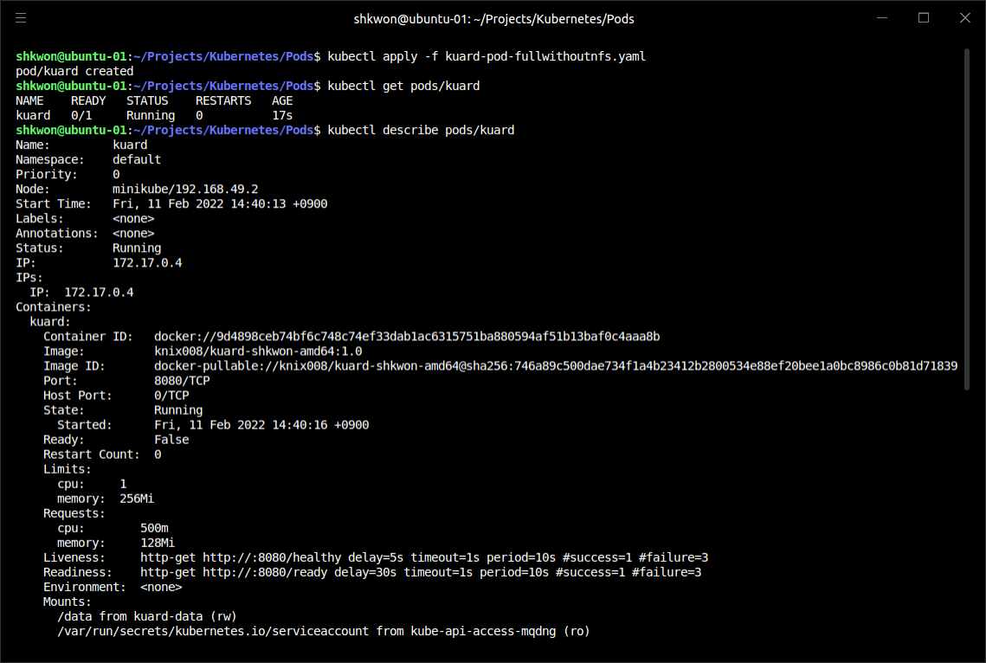
NOTE : Running Pod Manifest
The Result :
  We assume that you are running “minikube” now. Use “kubectl apply -f xxx.yaml” and “kubectl describe pods/xxx” commands. To remove pod, use “kubectl delete pods/xxx” command.

Slide 64
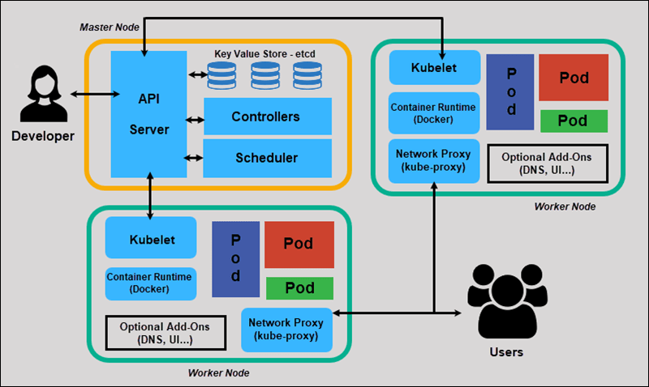
NOTE : Summary
Remember :
  Pods represent the atomic unit of work in a Kubernetes cluster. Pods are comprised of one or more containers working together symbiotically. To create a Pod, you write a Pod manifest and submit it to the Kubernetes API server by using the command-line tool or (less frequently) by making HTTP and JSON calls to the server directly.
  Once you’ve submitted the manifest to the API server, the Kubernetes scheduler finds a machine where the Pod can fit and schedules the Pod to that machine. Once scheduled, the kubelet daemon on that machine is responsible for creating the containers that correspond to the Pod, as well as performing any health checks defined in the Pod manifest.
  Once a Pod is scheduled to a node, no rescheduling occurs if that node fails. Additionally, to create multiple replicas of the same Pod you have to create and name them manually.

Slide 65
Labels and Annotations

Slide 66

What is Labels and Annotations?
Labels & Annotations :
  Kubernetes was made to grow with you as your application scales in both size and complexity. With this in mind, labels and annotations were added as foundational concepts. Labels and annotations let you work in sets of things that map to how you think about your application. You can organize, mark, and cross-index all of your resources to represent the groups that make the most sense for your application.
  Labels are key/value pairs that can be attached to Kubernetes objects such as Pods and ReplicaSets. They can be arbitrary, and are useful for attaching identifying information to Kubernetes objects. Labels provide the foundation for grouping objects.
  Annotations, on the other hand, provide a storage mechanism that resembles labels: annotations are key/value pairs designed to hold nonidentifying information that can be leveraged by tools and libraries.

Slide 67

Labels(1/14)
Identifying Metadata for Objects :
  Labels provide identifying metadata for objects. These are fundamental qualities of the object that will be used for grouping, viewing, and operating.
  NOTE : The motivations for labels grew out of Google’s experience in running large and complex applications. There were a couple of lessons that emerged from this experience. See the great site reliability book Site Reliability Engineering by Betsy Beyer et al. (O’Reilly) for some deeper background on how Google approaches production systems.
    The first lesson is that production abhors a singleton. When deploying software, users will often start with a single instance. However, as the application matures, these singletons often multiply and become sets of objects. With this in mind, Kubernetes uses labels to deal with sets of objects instead of single instances.
    The second lesson is that any hierarchy imposed by the system will fall short for many users. In addition, user groupings and hierarchies are subject to change over time. For instance, a user may start out with the idea that all apps are made up of many services. However, over time, a service may be shared across multiple apps. Kubernetes labels are flexible enough to adapt to these situations and more.

Slide 68
Labels(2/14)
Identifying Metadata for Objects :
  Labels have simple syntax. They are “key/value pairs”, where both the key and value are represented by strings. Label keys can be broken down into two parts: an optional prefix and a name, separated by a slash. The prefix, if specified, must be a “DNS subdomain” with a 253-character limit. The key name is required and must be shorter than 63 characters. Names must also start and end with an alphanumeric character and permit the use of dashes (-), underscores (_), and dots (.) between characters.
  Label values are strings with a maximum length of 63 characters. The contents of the label values follow the same rules as for label keys.
  When domain names are used in labels and annotations they are expected to be aligned to that particular entity in some way. For example, a project might define a canonical set of labels used to identify the various stages of application deployment (e.g., staging, canary, production). Or a cloud provider might define provider-specific annotations that extend Kubernetes objects to activate features specific to their service.

Slide 69
Labels(3/14)
Applying Labels :
  Here we create a few deployments (a way to create an array of Pods) with some interesting labels. We’ll take two apps (called alpaca and bandicoot) and have two environments for each. We will also have two different versions :
    First, create the alpaca-prod deployment and set the ver, app, and env labels with the following command :
    Next, create the alpaca-test deployment and set the ver, app, and env labels with the appropriate values :
    Finally, create two deployments for bandicoot. Here we name the environments prod and staging :
$ kubectl run alpaca-prod --image=knix008/kuard-shkwon-amd64:1.0 --labels="ver=1,app=alpaca,env=prod"
$ kubectl run alpaca-test --image=knix008/kuard-shkwon-amd64:1.0 --labels="ver=2,app=alpaca,env=test"
$ kubectl run bandicoot-prod --image=knix008/kuard-shkwon-amd64:1.0 --labels="ver=2,app=bandicoot,env=prod"
$ kubectl run bandicoot-staging --image=knix008/kuard-shkwon-amd64:1.0 --labels="ver=2,app=bandicoot,env=staging"

Slide 70

NOTE : Not Supporting “Replicas” in Run Command
Kubectl Version :
  The latest(2022.02.14) “kubectl” version is 1.23.3 and you cannot use “kubectl run … --replicas=x” command, which is not supported in this version. Instead, you can use “kubectl create” and “kubectl scale” commands to make replicas.
  The “kubectl create” command create a resource by filename or stdin and the “kubectl scale” command set a new size for a deployment, replica set, replication controller, or stateful set. Scale also allows users to specify one or more preconditions for the scale action.
  If you want to delete all pods in the “deployment” namespace, use “kubectl delete deployment --all” command.
$ kubectl create deployment --image=knix008/kuard-shkwon-amd64:1.0 my-example-app
$ kubectl scale deployment --replicas=5 my-example-app

Slide 71

Labels(4/14)
Applying Labels :
  At this point you should have four pods—alpaca-prod, alpaca-test, bandicoot-prod, and bandicoot-staging : To see them use “kubectl get pods --show-labels” command.
  We can visualize this as a Venn diagram based on the labels.

Slide 72

Labels(5/14)
Modifying Labels :
  Labels can also be applied (or updated) on objects after they are created :
$ kubectl label pods/alpaca-test "canary=true"

Slide 73


Labels(6/14)
Modifying Labels :
  You can also use the “-L” option to “kubectl get” to show a label value as a column :
  You can remove a label by applying a “dash suffix” :
$ kubectl get pods -L canary
$ kubectl label pods alpaca-test "canary-"

Slide 74

Labels(7/14)
Label Selectors :
  Label selectors are used to filter Kubernetes objects based on a set of labels. Selectors use a simple Boolean language. They are used both by end users (via tools like kubectl) and by different types of objects (such as how a ReplicaSet relates to its Pods).
  Each deployment (via a ReplicaSet) creates a set of Pods using the labels specified in the template embedded in the deployment. This is configured by the “kubectl run” command. Running the “kubectl get pods” command should return all the Pods currently running in the cluster.
  You may see a new label that we haven’t seen yet: pod-template-hash. This label is applied by the “deployment” so it can keep track of which Pods were generated from which template versions. This allows the deployment to manage updates in a clean way,
$ kubectl get pods --show-labels

Slide 75

Labels(8/14)
Label Selectors :
  If we only wanted to list Pods that had the “ver” label set to 2, we could use the --selector flag :
$ kubectl get pods --selector="ver=2"

Slide 76

Labels(9/14)
Label Selectors :
  If we specify two selectors separated by a comma, only the objects that satisfy both will be returned. This is a logical AND operation :
$ kubectl get pods --selector="app=bandicoot,ver=2"

Slide 77

Labels(10/14)
Label Selectors :
  We can also ask if a label is one of a set of values. Here we ask for all Pods where the “app” label is set to “alpaca” or “bandicoot” :
$ kubectl get pods --selector="app in (alpaca,bandicoot)"

Slide 78

Labels(11/14)
Label Selectors :
  Finally, we can ask if a label is set at all. Here we are asking for all of the pods with the “canary” label set to anything :
$ kubectl get pods --selector=“cannary”

Slide 79

Labels(12/14)
Label Selectors :
  There are also “negative” versions of “label selector”. See the following table :
  For example, asking if a key, “canary”, is not set can look like the following screen shot : Similarly, you can combine positive and negative selectors together as well :
$ kubectl get pods --selector='!canary'
$ kubectl get pods -l 'ver=2,!canary'

Slide 80
Labels(13/14)
Label Selectors in API Objects :
  When a Kubernetes object refers to a set of other Kubernetes objects, a label selector is used. Instead of a simple string as described in the previous section, we use a parsed structure.
  For historical reasons (Kubernetes doesn’t break API compatibility!), there are two forms. Most objects support a newer, more powerful set of selector operators.
  A selector of “app=alpaca,ver in (1, 2)” would be converted to this :
  All of the terms are evaluated as a “logical AND”. The only way to represent the “!=“ operator is to convert it to a “NotIn” expression with a single value. The older form of specifying selectors (used in “ReplicationControllers” and “services”) only supports the “=“ operator. This is a simple set of key/value pairs that must all match a target object to be selected.
  The selector “app=alpaca,ver=1” would be represented like this :
selector:
matchLabels:
app: alpaca
matchExpressions:
- {key: ver, operator: In, values: [1, 2]}
Compact YAML syntax. This is an item in a list (matchExpressions) that is a map with three entries. The last entry (values) has a value that is a list with two items.
selector:
app: alpaca
ver: 1

Slide 81
Labels(14/14)
Labels in the Kubernetes Architecture :
  In addition to enabling users to organize their infrastructure, labels play a critical role in linking various related Kubernetes objects. Kubernetes is a purposefully decoupled system. There is no hierarchy and all components operate independently. However, in many cases objects need to relate to one another, and these relationships are defined by labels and label selectors.
  For example, “ReplicaSets”, which create and maintain multiple replicas of a Pod, find the Pods that they are managing via a selector. Likewise, “a service load balancer” finds the Pods it should bring traffic to via a selector query. When a Pod is created, it can use a node selector to identify a particular set of nodes that it can be scheduled onto. When people want to restrict network traffic in their cluster, they use “NetworkPolicy” in conjunction with specific labels to identify Pods that should or should not be allowed to communicate with each other.
  Labels are a powerful and ubiquitous glue that holds a Kubernetes application together. Though your application will likely start out with a simple set of labels and queries, you should expect it to grow in size and sophistication with time.

Slide 82

Annotations(1/4)
Storing Extra Information :
  Annotations provide a place to store additional metadata for Kubernetes objects with the sole purpose of assisting tools and libraries. They are a way for other programs driving Kubernetes via an API to store some opaque data with an object. Annotations can be used for the tool itself or to pass configuration information between external systems.
  While labels are used to identify and group objects, annotations are used to provide extra information about where an object came from, how to use it, or policy around that object. There is overlap, and it is a matter of taste as to when to use an annotation or a label. When in doubt, add information to an object as an annotation and promote it to a label if you find yourself wanting to use it in a selector.

Slide 83

Annotations(2/4)
Usage :
  Keep track of a “reason” for the latest update to an object.
  Communicate a specialized scheduling policy to a specialized scheduler.
  Extend data about the last tool to update the resource and how it was updated (used for detecting changes by other tools and doing a smart merge).
  Attach build, release, or image information that isn’t appropriate for labels (may include a Git hash, timestamp, PR number, etc.).
  Enable the “Deployment” object to keep track of “ReplicaSets” that it is managing for rollouts.
  Provide extra data to enhance the visual quality or usability of a UI. For example, objects could include a link to an icon (or a base64-encoded version of an icon).
  Prototype alpha functionality in Kubernetes (instead of creating a first-class API field, the parameters for that functionality are encoded in an annotation).

Slide 84

Annotations(3/4)
Using Annotations :
  Annotations are used in various places in Kubernetes, with the primary use case being rolling deployments. During rolling deployments, annotations are used to track rollout status and provide the necessary information required to roll back a deployment to a previous state.
  Users should avoid using the Kubernetes API server as a general-purpose database. Annotations are good for small bits of data that are highly associated with a specific resource. If you want to store data in Kubernetes but you don’t have an obvious object to associate it with, consider storing that data in some other, more appropriate database.

Slide 85
Annotations(4/4)
Defining Annotations :
  Annotation keys use the same format as label keys. However, because they are often used to communicate information between tools, the “namespace” part of the key is more important. Example keys include “deployment.kubernetes.io/revision” or “kubernetes.io/change-cause”.
  The value component of an annotation is a free-form string field. While this allows maximum flexibility as users can store arbitrary data, because this is arbitrary text, there is no validation of any format. For example, it is not uncommon for a JSON document to be encoded as a string and stored in an annotation. It is important to note that the Kubernetes server has no knowledge of the required format of annotation values. If annotations are used to pass or store data, there is no guarantee the data is valid. This can make tracking down errors more difficult.
  Annotations are defined in the common metadata section in every Kubernetes object :
  NOTE : Annotations are very convenient and provide powerful loose coupling. However, they should be used judiciously to avoid an untyped mess of data.
...
metadata:
annotations:
example.com/icon-url: "https://example.com/icon.png"
...

Slide 86

Cleanup
Removing Pods :
  It is easy to clean up all of the Pods. Use the following command. If you want to be more selective, you can use the “--selector” flag to choose which Pods to delete.
$ kubectl delete pods --all

Slide 87

NOTE : Summary
Remember :
  Labels are used to identify and optionally group objects in a Kubernetes cluster. Labels are also used in selector queries to provide flexible runtime grouping of objects such as Pods.
  Annotations provide object-scoped key/value storage of metadata that can be used by automation tooling and client libraries. Annotations can also be used to hold configuration data for external tools such as third-party schedulers and monitoring tools.
  Labels and annotations are vital to understanding how key components in a Kubernetes cluster work together to ensure the desired cluster state. Using labels and annotations properly unlocks the true power of Kubernetes’s flexibility and provides the starting point for building automation tools and deployment workflows.

Slide 88
Service Discovery

Slide 89

Dynamic System
Autoscaling :
  Kubernetes is a very dynamic system. The system is involved in placing Pods on nodes, making sure they are up and running, and rescheduling them as needed. There are ways to automatically change the number of Pods based on load (such as horizontal Pod autoscaling). The API-driven nature of the system encourages others to create higher and higher levels of automation.
  While the dynamic nature of Kubernetes makes it easy to run a lot of things, it creates problems when it comes to finding those things. Most of the traditional network infrastructure wasn’t built for the level of dynamism that Kubernetes presents.

Slide 90

What Is Service Discovery?
Service Discovery :
  Service-discovery tools help solve the problem of finding which processes are listening at which addresses for which services. A good service-discovery system will enable users to resolve this information quickly and reliably. A good system is also low-latency; clients are updated soon after the information associated with a service changes. Finally, a good service-discovery system can store a richer definition of what that service is. For example, perhaps there are multiple ports associated with the service.
  The Domain Name System (DNS) is the traditional system of service discovery on the internet. DNS is designed for relatively stable name resolution with wide and efficient caching. It is a great system for the internet but falls short in the dynamic world of Kubernetes.
  Unfortunately, many systems (for example, Java, by default) look up a name in DNS directly and never re-resolve. This can lead to clients caching stale mappings and talking to the wrong IP. Even with short TTLs(Time-To-Lives) and well-behaved clients, there is a natural delay between when a name resolution changes and when the client notices. There are natural limits to the amount and type of information that can be returned in a typical DNS query, too. Things start to break past 20–30 “A records” for a single name. SRV records solve some problems, but are often very hard to use. Finally, the way that clients handle multiple IPs in a DNS record is usually to take the first IP address and rely on the DNS server to randomize or round-robin the order of records. This is no substitute for more purpose-built load balancing.

Slide 91

NOTE : Domain Name System
DNS A Record :
  The "A" stands for "address" and this is the most fundamental type of DNS record : it indicates the IP address of a given domain. For example, if you pull the DNS records of cloudflare.com, the “A” record currently returns an IP address of: “104.17.210.9”.
  “A” records only hold IPv4 addresses. If a website has an IPv6 address, it will instead use an "AAAA" record.
  Here is an example of an “A” record :
  The "@" symbol in this example indicates that this is a record for the “root domain”, and the "14400" value is the TTL (time to live), listed in seconds. The default TTL for “A” records is “14,400” seconds. This means that if an A record gets updated, it takes “240” minutes (14,400 seconds) to take effect.
  The vast majority of websites only have one “A” record, but it is possible to have several. Some higher profile websites will have several different “A” records as part of a technique called “round robin load balancing”, which can distribute request traffic to one of several IP addresses, each hosting identical content.

Slide 92

The Service Object(1/3)
Creating Service Object :
  Real service discovery in Kubernetes starts with a Service object. A Service object is a way to create a named label selector. As the “kubectl run” command is an easy way to create a Kubernetes deployment, we can use “kubectl expose” to create a service.
  Let’s create some deployments and services so we can see how they work :
$ minikube start
$ kubectl run alpaca-prod \
--image=knix008/kuard-shkwon-amd64:1.0 \
--port=8080 \
--labels="ver=1,app=alpaca,env=prod"
$ kubectl expose pods/alpaca-prod
$ kubectl run bandicoot-prod \
--image=knix008/kuard-shkwon-amd64:1.0 \
--port=8080 \
--labels="ver=2,app=bandicoot,env=prod"
$ kubectl expose pods/bandicoot-prod
$ kubectl get services -o wide

Slide 93
The Service Object(2/3)
Creating Service Object :
  After running the previous commands, we have three services. The ones we just created are alpaca-prod and bandicoot-prod. The kubernetes service is automatically created for you so that you can find and talk to the Kubernetes API from within the app.
  If we look at the “SELECTOR” column, we see that the “alpaca-prod service” simply gives a name to a selector and specifies which ports to talk to for that service. The “kubectl expose” command will conveniently pull both the label selector and the relevant ports (8080, in this case) from the “pods” definition.
  NOTE : If you use “kubectl create” command, you can use “deployment” definition instead.

Slide 94


The Service Object(3/3)
Creating Service Object :
  Furthermore, that service is assigned a new type of virtual IP called a “cluster IP”. This is a special IP address the system will load-balance across all of the Pods that are identified by the selector.
  To interact with services, we are going to “port forward“ to the “alpaca Pods”. Start and leave this command running in a terminal window. You can see the port forward working by accessing the “alpaca Pod” at http://localhost:48858 :
$ ALPACA_POD=$(kubectl get pods -l app=alpaca \
-o jsonpath='{.items[0].metadata.name}')
$ kubectl port-forward $ALPACA_POD 48858:8080

Slide 95


Service DNS(1/2)
DNS Service :
  Because the cluster IP is virtual, it is stable, and it is appropriate to give it a DNS address. All of the issues around clients caching DNS results no longer apply. Within a namespace, it is as easy as just using the service name to connect to the Pods identified by a service.
  Kubernetes provides a DNS service exposed to Pods running in the cluster. This Kubernetes DNS service was installed as a system component when the cluster was first created. The DNS service is, itself, managed by Kubernetes and is a great example of Kubernetes building on Kubernetes. The Kubernetes DNS service provides DNS names for cluster IPs.
  You can try this out by expanding the “DNS Query” section on the “kuard” server status page. Query the “A record” for “alpaca-prod”. The output should look something like this :

Slide 96
Service DNS(2/2)
DNS Service :
  The full DNS name here is “alpaca-prod.default.svc.cluster.local.”.
    “alpaca-prod” - The name of the service in question.
    “default” - The namespace that this service is in.
    “svc” - Recognizing that this is a service. This allows Kubernetes to expose other types of things as DNS in the future.
    “cluster.local.” - The base domain name for the cluster. This is the default and what you will see for most clusters. Administrators may change this to allow unique DNS names across multiple clusters.
  When referring to a service in your own namespace you can just use the service name (“alpaca-prod”). You can also refer to a service in another namespace with “alpaca-prod.default”. And, of course, you can use the fully qualified service name (“alpaca-prod.default.svc.cluster.local.”). Try each of these out in the “DNS Query” section of “kuard”.

Slide 97

Readiness Checks(1/4)
Updating Service Readiness :
  Often, when an application first starts up it isn’t ready to handle requests. There is usually some amount of initialization that can take anywhere from under a second to several minutes. One nice thing the Service object does is track which of your Pods are ready via a readiness check. Let’s modify our deployment to add a readiness check that is attached to a Pod :
  This command will fetch the current version of the alpaca-prod Pods and bring it up in an editor. After you save and quit your editor, it’ll then write the object back to Kubernetes. This is a quick way to edit an object without saving it to a YAML file.
$ kubectl edit pods/alpaca-prod

Slide 98

Readiness Checks(2/4)
Updating Service Readiness :
  Add the following section :
  This sets up the Pods so that they will be checked for readiness via an HTTP GET to /ready on port 8080. This check is done every 2 seconds starting as soon as the Pod comes up. If three successive checks fail, then the Pod will be considered not ready. However, if only one check succeeds, the Pod will again be considered ready.
  NOTICE : Only ready Pods are sent traffic.
spec:
...
template:
...
spec:
containers:
...
name: alpaca-prod
readinessProbe:
httpGet:
path: /ready
port: 8080
periodSeconds: 2
initialDelaySeconds: 0
failureThreshold: 3
successThreshold: 1

Slide 99

NOTE : Editing Configuration File
Editing :
  NOTE : For more information about “kubectl edit” command, refer to https://kubernetes.io/ko/docs/concepts/cluster-administration/manage-deployment/.
  You can use the following commands to re-configure the service.
$ kubectl get pods/alpaca-prod -o yaml > ./kuard-shkwon-amd64.yaml
$ vi kuard-shkwon-amd64.yaml
# After done editing, save the file. with “:wq” command in “vi”
$ kubectl apply -f kuard-shkwon-amd64.yaml
$ rm ./kuard-shkwon-amd64.yaml

Slide 100


Readiness Checks(3/4)
Updating Service Readiness :
  Updating the Pods definition will delete and recreate the alpaca Pods. As such, we need to restart our port-forward command from earlier :
  Point your browser to http://localhost:48858 and you should see the debug page for that instance of “kuard”. Expand the “Readiness Probe” section. You should see this page update every time there is a new readiness check from the system, which should happen every 2 seconds.
$ ALPACA_POD=$(kubectl get pods -l app=alpaca \
-o jsonpath='{.items[0].metadata.name}')
$ kubectl port-forward $ALPACA_POD 48858:8080

Slide 101


Readiness Checks(4/4)
Updating Service Readiness :
  In another terminal window, start a watch command on the endpoints for the “alpaca-prod” service. Endpoints are a lower-level way of finding what a service is sending traffic to. The “--watch” option here causes the “kubectl” command to hang around and output any updates. This is an easy way to see how a Kubernetes object changes over time :
  Now go back to your browser and hit the “Fail” link for the readiness check. You should see that the server is now returning 500s. After three of these, this server is removed from the list of endpoints for the service. Hit the “Succeed” link and notice that after a single readiness check the endpoint is added back.
  This readiness check is a way for an overloaded or sick server to signal to the system that it doesn’t want to receive traffic anymore. This is a great way to implement “graceful shutdown”. The server can signal that it no longer wants traffic, wait until existing connections are closed, and then cleanly exit.
  Press “Ctrl-C” to exit out of both the port-forward and watch commands in your terminals.
$ kubectl get endpoints alpaca-prod --watch

Slide 102
Looking Beyond the Cluster(1/3)
NodePorts Feature :
  Oftentimes, the IPs for Pods are only reachable from within the cluster. At some point, we have to allow new traffic in!.
  The most portable way to do this is to use a feature called “NodePorts”, which enhance a service even further. In addition to a cluster IP, the system picks a port (or the user can specify one), and every node in the cluster then forwards traffic to that port to the service.
  With this feature, if you can reach any node in the cluster you can contact a service. You use the “NodePort” without knowing where any of the Pods for that service are running. This can be integrated with hardware or software load balancers to expose the service further.
  Try this out by modifying the “alpaca-prod” service :
$ kubectl edit service alpaca-prod

Slide 103

Looking Beyond the Cluster(2/3)
NodePorts Feature :
  Change the “spec.type” field to “NodePort”. You can also do this when creating the service via “kubectl expose” command by specifying “--type=NodePort”. The system will assign a new “NodePort” :
$ kubectl describe service alpaca-prod

Slide 104

Looking Beyond the Cluster(3/3)
NodePorts Feature :
  Here we see that the system assigned port “30073” to this service. Now we can hit any of our cluster nodes on that port to access the service. If you are sitting on the same network, you can access it directly. If your cluster is in the cloud someplace, you can use “SSH tunneling” with something like this :
  Now if you point your browser to http://localhost:8080 you will be connected to that service. Each request that you send to the service will be randomly directed to one of the Pods that implements the service(Now, we have no replicas!!! You can just connect to only one Pod now.). Reload the page a few times and you will see that you are randomly assigned to different Pods.
  NOTE : For more information about SSH(Secure Shell), please see https://phoenixnap.com/kb/ssh-to-connect-to-remote-server-linux-or-windows.
$ ssh <node> -L 8080:localhost:30073

Slide 105

Cloud Integration(1/2)
LoadBalancer Type :
  If you have support from the cloud that you are running on (and your cluster is configured to take advantage of it), you can use the “LoadBalancer” type. This builds on the “NodePort” type by additionally configuring the cloud to create a new load balancer and direct it at nodes in your cluster.
  Edit the “alpaca-prod” service again (“kubectl edit service alpaca-prod”) and change “spec.type” to “LoadBalancer”. If you do a “kubectl get services” right away you’ll see that the “EXTERNAL-IP” column for “alpaca-prod” now says “<pending>”. Wait a bit and you should see a public address assigned by your cloud. You can look in the console for your cloud account and see the configuration work that Kubernetes did for you :

Slide 106

Cloud Integration(2/2)
LoadBalancer Type :
  NOTE : The way a load balancer is configured is specific to a cloud. In addition, some clouds have DNS-based load balancers (e.g., AWS ELB). In that case you’ll see a hostname here instead of an IP(in “LoadBalancer” field in “kubectl describe service xxxx” command. But, in the previous example, we are not using cloud now. So you cannot see that field.). Also, depending on the cloud provider, it may still take a little while for the load balancer to be fully operational.
  NOTE : Creating a cloud-based load balancer can take some time. Don’t be surprised if it takes a few minutes on most cloud providers.

Slide 107

Advanced Details(1/10)
Endpoints :
  Some applications (and the system itself) want to be able to use services without using a cluster IP. This is done with another type of object called an “Endpoints object”. For every Service object, Kubernetes creates a buddy Endpoints object that contains the IP addresses for that service :
$ kubectl describe endpoints alpaca-prod

Slide 108

Advanced Details(2/10)
Endpoints :
  To use a service, an advanced application can talk to the Kubernetes API directly to look up endpoints and call them. The Kubernetes API even has the capability to “watch” objects and be notified as soon as they change. In this way, a client can react immediately as soon as the IPs associated with a service change.
  Let’s demonstrate this. In a terminal window, start the following command and leave it running :
  It will output the current state of the endpoint and then “hang”(waiting) : In our case, we only have one endpoint now. If you created more, then you will see more endpoints in the output window.
$ kubectl get endpoints alpaca-prod --watch

Slide 109


Advanced Details(3/10)
Endpoints :
  Now open up another terminal window and delete and recreate the pods backing “alpaca-prod” :
$ kubectl delete pod/alpaca-prod
$ kubectl run alpaca-prod \
--image=knix008/kuard-shkwon-amd64:1.0 \
--port=8080 \
--labels="ver=1,app=alpaca,env=prod"

Slide 110

Advanced Details(4/10)
Endpoints :
  If you look back at the output from the watched endpoint, you will see that as you deleted and re-created these Pods, the output of the command reflected the most up-to-date set of IP addresses associated with the service.
  The Endpoints object is great if you are writing new code that is built to run on Kubernetes from the start. But most projects aren’t in this position! Most existing systems are built to work with regular old IP addresses that don’t change that often.

Slide 111

Advanced Details(5/10)
Manual Service Discovery :
  Kubernetes services are built on top of label selectors over Pods. That means that you can use the Kubernetes API to do rudimentary service discovery without using a Service object at all! With kubectl (and via the API) we can easily see what IPs are assigned to each Pod in our example :
  This is great, but what if you have a ton of Pods? You’ll probably want to filter this based on the labels applied as part of the pod.
$ kubectl get pods -o wide --show-labels

Slide 112

Advanced Details(6/10)
Manual Service Discovery :
  Let’s do that for just the “alpaca” app :
  You can always use labels to identify the set of Pods you are interested in, get all of the Pods for those labels, and dig out the IP address. But keeping the correct set of labels to use in sync can be tricky(little bit hard). This is why the “Service object” was created.
$ kubectl get pods -o wide --selector=app=alpaca,env=prod

Slide 113
Advanced Details(7/10)
“kube-proxy” and Cluster IPs :
  Cluster IPs are stable virtual IPs that load-balance traffic across all of the endpoints in a service. This magic is performed by a component running on every node in the cluster called the “kube-proxy”.
  The “kube-proxy” watches for new services in the cluster via the API server. It then programs a set of iptables rules in the kernel of that host to rewrite the destinations of packets so they are directed at one of the endpoints for that service. If the set of endpoints for a service changes (due to Pods coming and going or due to a failed readiness check), the set of iptables rules is rewritten.
  The cluster IP itself is usually assigned by the API server as the service is created. However, when creating the service, the user can specify a specific cluster IP. Once set, the cluster IP cannot be modified without deleting and recreating the Service object.
  NOTE : The Kubernetes service address range is configured using the “--service-cluster-ip-range” flag on the kube-apiserver binary. The service address range should not overlap with the IP subnets and ranges assigned to each Docker bridge or Kubernetes node. In addition, any explicit cluster IP requested must come from that range and not already be in use.

Slide 114

Advanced Details(8/10)
Cluster IP Environment Variables :
  While most users should be using the DNS services to find cluster IPs, there are some older mechanisms that may still be in use. One of these is injecting a set of environment variables into Pods as they start up.
  Enter the following commands in your terminal :
$ ALPACA_POD=$(kubectl get pods -l app=alpaca \
-o jsonpath='{.items[0].metadata.name}')
$ kubectl port-forward $ALPACA_POD 48858:8080

Slide 115

Advanced Details(9/10)
Cluster IP Environment Variables :
  Now point your browser to http://localhost:48858 to see the status page for this server. Expand the “Server Env” section and note the set of environment variables for the alpaca service.

Slide 116

Advanced Details(10/10)
Cluster IP Environment Variables :
  The two main environment variables to use are “ALPACA_PROD_SERVICE_HOST" and “ALPACA_PROD_SERVICE_PORT”. The other environment variables are created to be compatible with (now deprecated) Docker link variables.
  A problem with the environment variable approach is that it requires resources to be created in a specific order. The services must be created before the Pods that reference them. This can introduce quite a bit of complexity when deploying a set of services that make up a larger application. In addition, using just environment variables seems strange to many users. For this reason, “DNS” is probably a better option.

Slide 117

Connecting with Other Environments
Integrating with Legacy System :
  Many real-world applications actually require that you integrate more cloud-native applications deployed in Kubernetes with applications deployed to more legacy environments. Additionally, you may need to integrate a Kubernetes cluster in the cloud with infrastructure that has been deployed on-premise.
  This is an area of Kubernetes that is still undergoing a fair amount of exploration and development of solutions. When you are connecting Kubernetes to legacy resources outside of the cluster, you can use selector-less services to declare a Kubernetes service with a manually assigned IP address that is outside of the cluster. That way, Kubernetes service discovery via DNS works as expected, but the network traffic itself flows to an external resource.
  Connecting external resources to Kubernetes services is somewhat trickier. If your cloud provider supports it, the easiest thing to do is to create an “internal” load balancer that lives in your virtual private network and can deliver traffic from a fixed IP address into the cluster. You can then use traditional DNS to make this IP address available to the external resource.
  Another option is to run the full “kube-proxy” on an external resource and program that machine to use the DNS server in the Kubernetes cluster. Such a setup is significantly more difficult to get right and should really only be used in on-premise environments. There are also a variety of open source projects (for example, Hashicorp’s Consul) that can be used to manage connectivity between in-cluster and out-of-cluster resources.

Slide 118

Cleanup
Deleting Objects :
  Run the following command to clean up all of the objects created.
  NOTE : Here we didn’t use “kubectl create” command. So you don’t need to delete “deployments” now. Anyway, if you want to delete all “services, deployments and pods”, you can use the previous command.
$ kubectl delete services,deployments, pods -l app

Slide 119
NOTE : Summary
Remember :
  Kubernetes is a dynamic system that challenges traditional methods of naming and connecting services over the network.
  The Service object provides a flexible and powerful way to expose services both within the cluster and beyond. With the techniques covered here you can connect services to each other and expose them outside the cluster.
  Once your application can dynamically find services and react to the dynamic placement of those applications, you are free to stop worrying about where things are running and when they move. It is a critical piece of the puzzle to start to think about services in a logical way and let Kubernetes take care of the details of container placement.

Slide 120

Reference
[1] Kubernetes: Up and Running, Dive into the Future of Infrastructure, Brendan Burns, Joe Beda, and Kelsey Hightower, Oreilly, 2nd Edition, 2019.
[2] https://github.com/kubernetes-up-and-running/kuard
[3] https://www.oreilly.com/library/view/kubernetes-up-and/9781492046523/
[4] https://github.com/surfer190/fixes/blob/master/docs/kubernetes/kubernetes-up-and-running.md
[5] https://medium.com/finda-tech/overview-8d169b2a54ff
[6] https://kubernetes.io/ko/docs/concepts/cluster-administration/manage-deployment/

Slide 121

? & !

